Slide 1
The power of intercultural communication- are we clear?
Emma Bourassa

Slide 2
yes

Slide 3
yes
Direct
Indirect
Agreement
Approval
Acceptance
Understanding
Acknowledgement
Polite/respectful

Slide 4
You answered yes, that means you understand
I don’t want to embarrass you but what are you talking about?

Slide 5
From the perspective of the receiver…
Direct communication can seem
rude and abrupt:
Those numbers are wrong.
Indirect communication can seem confusing
We will do our best.

Slide 6
Those numbers are incorrect.
Can we double check those numbers?
We will try our best.
We need more time to complete.
More direct more indirect

Slide 7
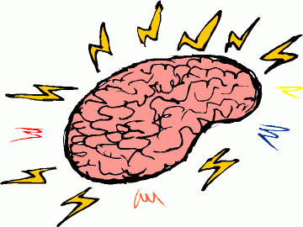

Slide 9
Next up
Complete the Craig Storti Direct/indirect exercise which is available right under this video.
Direct and indirect communication styles are just one pattern of communication. Of course it is contextual and on a continuum. To be more effective at communicating, especially in an intercultural situation, the more one knows, is attentive to, and able to adjust to another style, the more likely what needs to get done for both happens with minimal stress and effort. Next up, we’ll look at some other patterns and explore the values that align with the styles.

Slide 10
I’m wondering if that was direct and clear enough………

