Slide 1
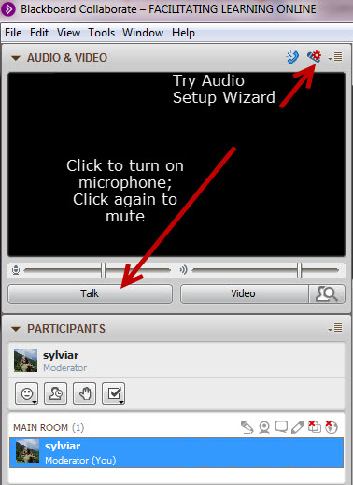
Day, Date “Construction Tips” time PST
While you’re waiting:
Plug in your headset/microphone and do the Audio Setup Wizard.
Say “Hi” – click on the Talk button.
Mute your microphone unless you’re speaking
Get attention by raising your hand or type in the chat (bottom left)
This session will be
recorded
Notes:
Check if anyone has not attended a Collaborate session yet – do they need a refresher on the basic tools? (whiteboard adding text tools)

Slide 2
Proposed Agenda
Community Check-in
Mid-point Milestones
Burning Questions
The Design Project vs Prototype
???
Notes:
Review – ask them if they have additional agenda items – we can add as we go too – but hold till the end.

Slide 3
Check-in
Add a check-in activity – icebreaker type?
Notes:
How’s everyone feeling at this point in Week 3?

Slide 4
Mid-point Milestones
Design Topic
Design Approach
Select
OLA
Team
?
Select Drawing Tool
Develop
Dwg
Finalize
Plan
Begin
Plan
Develop
Plan
Describe
OLA
Notes:
Show visual milestones for Design project – talk about underlying expectations? That they share at the end of each week and provide some feedback to other projects. Maybe too challenging?
good spot to remind of a plan within a plan- the 2nd Develop Plan is the plan within the plan, right?

Slide 5
Alignment
Intended
Learning
Outcomes
Discuss important elements of online learning design…
Plan a short unit of online learning …
Plan a prototype online learning activity…
Present and explain learning design project and prototype with peers
Participate in collaborative, constructive review and feedback of design projects
Notes:
Quick review of learning outcomes relevant to the design project (check if they’ve read them first- in Handbook)
What are their intentions / objectives / expectations
Review –
Discuss important elements…. – part of ongoing Studio conversations and each Week’s Overview
Unit of Learning - some or all of elements in planning template and some elements that are shared in Week 3 Overview – some quality and accessibility design guidelines
Plan should allow us to understand how a learner would be engaged and guided in learning some part of the LOs for the unit
Prepare a “showcase” presentation – 10 min synchronous / or asynchronous screencast (with audio/video?) explain choices
Participate in collaborative…etc.

Slide 6
What are your challenges right now?
What kind of help do you need to design the learning activity?
Notes:
A choice to go into groups or work as a whole? Depends how many show up?

Slide 7
Summary
Notes:
As we listen or listen in, we could compile what we ?

Slide 8
Notes:
Any questions

