Slide 1
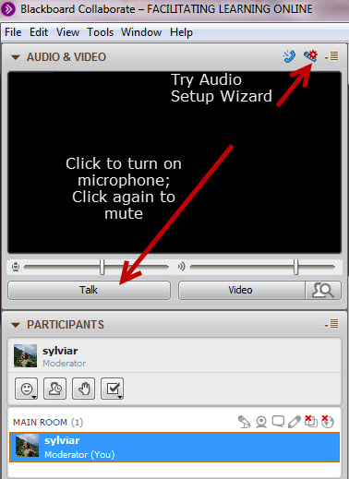
Day, date time PST “Design Options”
While you’re waiting:
Plug in your headset/microphone and do the Audio Setup Wizard.
Say “Hi” – click on the Talk button.
Mute your microphone unless you’re speaking
Get attention by raising your hand or type in the chat (bottom left)
This session will be
recorded
Notes:
Rather than spending time on a check in activity - We’ll do a final runthrough and have everyone take turns - open mic turn on video? and say Hi and your name (if no mic, type in Chat and one of us will speak their name

Slide 2
Proposed Agenda
Community check-in
Review instructional (learning) design approaches
Example of outcomes-based, integrated design
Example of design thinking for education
Example of open education
Any stories to share ?
Notes:
Review – ask them if they brought any stories to share? If yes, can cut back on some of the examples? and leave room at end to share stories? What elements of design did they find unique? Something they think others might want to think about?

Slide 3
Three Approaches
1
Outcomes-based
Learning Outcomes (Objectives)
Assessment
Teaching and Learning Activities
2
Design Thinking
Understand the learner
Define problem and purpose
Imagine (Ideate)
Develop something to test (prototype)
Test on sample audience
Notes:
A basic structure used in much of higher education – learner-focused – important that teaching and learning strategies contribute to achievement of intended outcomes and that assessments are meaningful and aligned with LOs
Advantage is consistency, and quality – if done well.
Stanford interpretation- will share an example later

Slide 4
Three Approaches
3
Open
5 “Rs” – Retain, Reuse, Revise, Remix, Redistribute
Open Pedagogy or Open Practices
OERs
Students as producers not consumers
Notes:
Open Education has many interpretations
David Wiley’s 5 “R”s focus on the importance of open resources to enable the ability for instructors to freely repurpose content for learning in context
Open resources support the possibility of enabling students to become producers or contributors to their own learning
Again, this approach or the values underlying openness can be applied to design, to teaching and to the way students learn.

Slide 5
Add your own stories?
See explainer stories files in Facilitator Resources

Slide 6
Notes:
More stories? inspiring ideas, sparks?
What do you need from us?

Slide 7
Your turn
We’ve done a lot in 1 week, and there’s more to come!
What do you need from us?
clarity?
examples?
other?
Notes:
will be posted.

