Slide 1
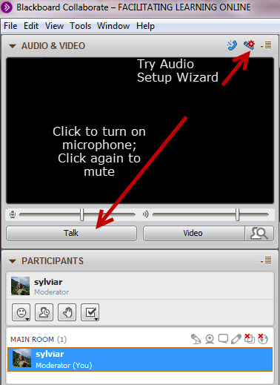
Day, Date “Welcome” time - PST
While you’re waiting:
Plug in your headset/microphone and do the Audio Setup Wizard.
Say “Hi” – click on the Talk button.
Mute your microphone unless you’re speaking
Get attention by raising your hand or type in the chat (bottom left)
This session will be
recorded

Slide 2
Proposed Agenda
Community check-in
Get the picture?
Looking ahead
The Design Project
Reflective practices
Agreements
Week 1 Checklist – Questions?
???
Notes:
12:05???
(2 min)
Review – ask them if they have additional agenda items – we can add as we go too – but hold till the end.

Slide 3
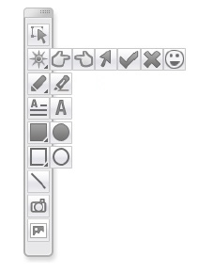
Who’s here?
Say your name & what you do
1
Click on Talk button
2
3
Put a checkmark beside your name
or Raise Hand
Click on Talk button
to Mute
Insert screen caps of participant profile avatar & name?
Notes:
S Screencap of List of Participants
Encourage people to add profile pics if they haven’t done so already
Explain Whiteboard tools. Ask each person – alphabetically by first name from the bottom of the list (point out how to scroll down) to Open Mic – Say their name and “HI” – Mute their Mic and Place a check mark beside their name in the List.

Slide 4
Let’s try this…
Focus on each sense for you right now
Consider which sense is the strongest
Open mic - share what that sense is telling you

Slide 5
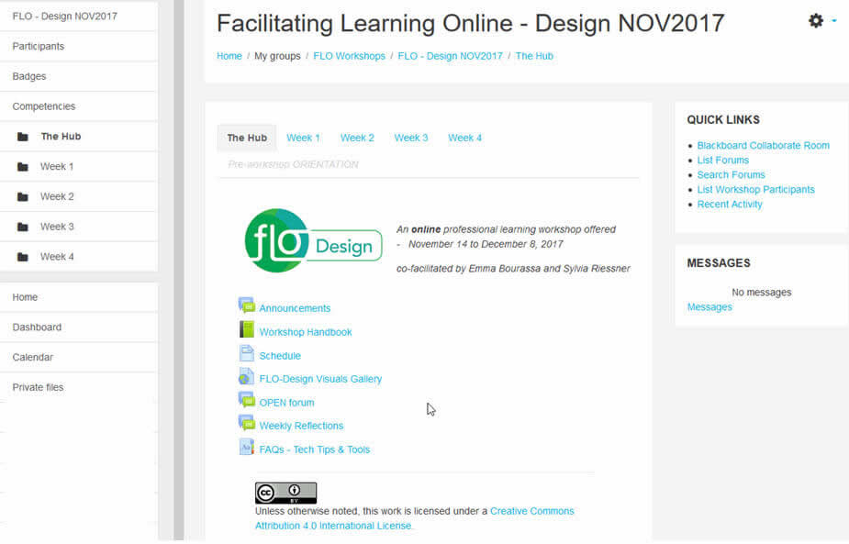
Notes:
E Any questions about how to find things or where to get started?
Just to restate the organization - the Hub holds forums and resources you’ll use throughout the next 4 weeks.
Weekly tabbed pages contain the resources and activities you will work on during that week.
Quick Links are useful to track activity, find forums and join Collaborate sessions

Slide 6
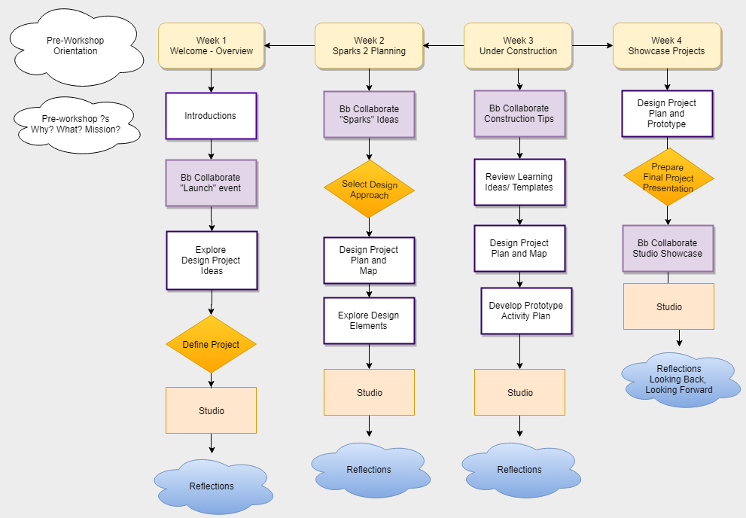
Get the picture?
Notes:
Explain visual schedule – mention the Visuals Gallery on Hub
Point out that these visuals are deliberately simple - to allow people to focus on the essential they want to communicate
highlight the design project (we’ll talk about actual design project in a bit)
the reflective practice elements (note this becomes a final LB/LF activity in Week4 - again - more detail a little later
the Studio sharing and intentionality
think about what kind of feedback they need on their project

Slide 7
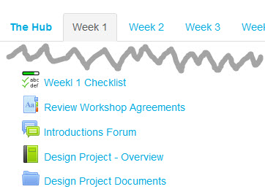
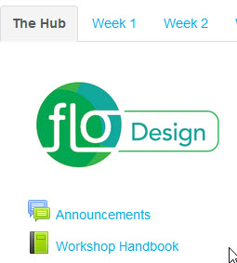
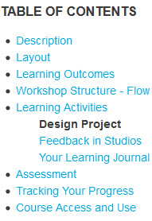
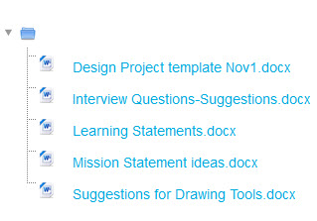
Design Project
Notes:
We asked you to think about what you wanted to design or learn about design (Pre-workshop Survey).
figuring what you wanted to accomplish - what your ‘mission” was and some ideas around topic and learners - you may or may not have a clear idea of this
We ask you to focus on a 2-3 week unit of learning online - to make sure you don’t get bogged down in detailed construction.
The focus is to think about your learner, your design choices, and to share and discuss them with others.
The process is explained in the Design Overview - plus some ideas for topics you could use or focus on?
In the Design Project Documents:
Mission Statement (clarify topic - if you can)
Interview Questions (Emma will explain in next slide)

Slide 8
Getting into the groove
Open the Interview Teams page
Make a plan to ‘meet’ your partner
This gives an opportunity for everyone to have a look at all the interests and potentially create a team (we recommend 3 as a maximum)
Notes:
Purpose is to expose you to different ideas and see if there is someone you want to work with and to consider your mission. The first interview activity happens over the next couple of days.
We do have time dates, which I’ll talk about at the end of today. Don’t worry right now, we’ll spend time today to get you started on this interview activity.

Slide 9
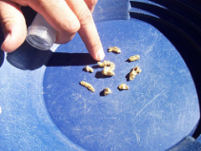
Reflective practice
Document your process
Respond to weekly question in Weekly Reflections
Consider others’ ideas
Discuss further in weekly studio
Weekly Reflections is your response to the post.
It’s an opportunity to listen to others.
Notes:
Note that the term “reflective practice” may be interpreted differently.
Our orientation is based on the work of The Institute of Public Affairs.
The aim is to really be aware of your thinking, how that thinking may change and your process as you engage with your plan and partner/s if you decide to collaborate.
The learning journal is a free space- doodle, write, make symbols- whatever works for you. This is a personal artifact of your experience in the FLO Design that no one but you sees.
In the Weekly reflection, we’ll pose a question to orient your reflective practice. The weekly question will be posted by Thursday noon. Post your answer and read some of the other posts. This is a space for noticing what is happening for others, then taking some time to consider whether you would like to engage in a more extended conversation about an idea. This reflections forum is a place for “listening”.
Conversations and responses to peers will happen in the studio space as this is where the ongoing design of your unit will be shared. The choices you are considering/making possible questions/ideas about those choices are in the studio space for each week. We’ll be reminding you as you get familiar with the various forums. The first reflective question will be posted by tomorrow morning.
You don’t have to respond to anyone else’s reflection, but do read some as it can provide some insight that may be of interest and use to you.
For example, if Sylvia noted she is wondering about how much to write, and feels it is a struggle, I might go to her studio space and ask her how generating ideas for her plan is going and ask her if she’d like a suggestion that might work for journaling and the plan. There are many directions that the studio space discussions can evolve.

Slide 10
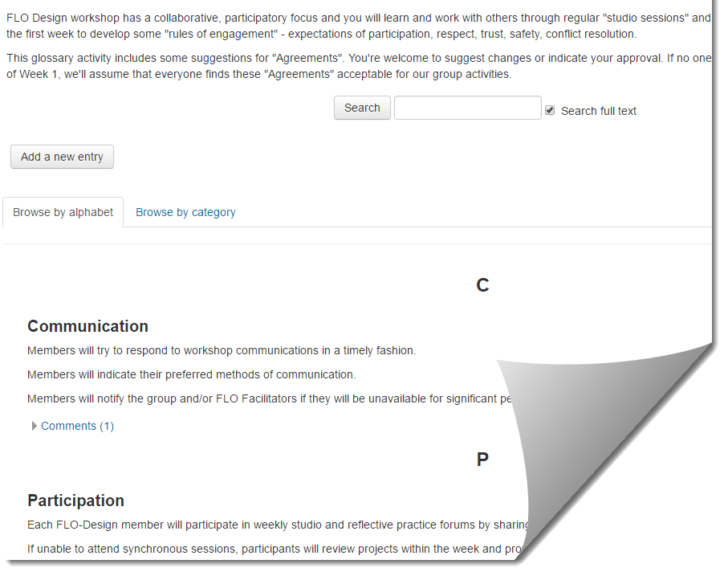
Agreements
Notes:
Poll previous ISW participants?
Do you know what agreements are/are for? yes/no
Glossary items - can comment
No repsonses? = all that is there is agreed to

Slide 11
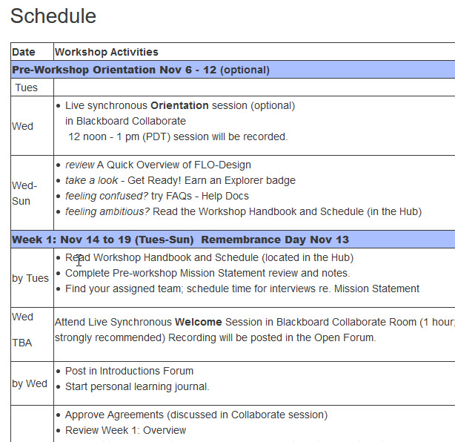
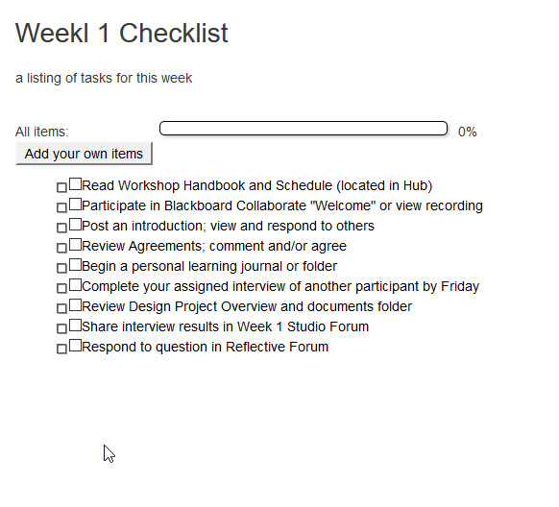
Track your progress
Notes:
For those who are list oriented, 2 ways - the checklist is flexible to add your items which only you see and you can check off which is visible to the facilitator

Slide 12
Notes:
Any questions can be asked now, and answers will be posted in open forum

Slide 13
Make a plan, be prepared
Make a plan to ‘meet’ your partner
Post in Studio Forum
Saturday midday - post Interview summary
Sunday evening - post your choice: work alone or in a team
This gives an opportunity for everyone to have a look at all the interests and potentially create a team (we recommend 3 as a maximum)
Notes:
Now you know what the assignment purpose is. Now we need you to make a plan. Make a plan to meet your partner. You’ll find your partner in Week 1 Interview teams. You will interview each other and post whatever you find out from your partner in the Week 1 studio forum. It is okay if there is not total clarity at this point of the workshop.
Are there any concerns as to how be in contact with your partner? We’re going to stop the recording and we will stay in this room and be here if you need us. Otherwise, Go ahead and find your partner and make contact.

