Slide 1
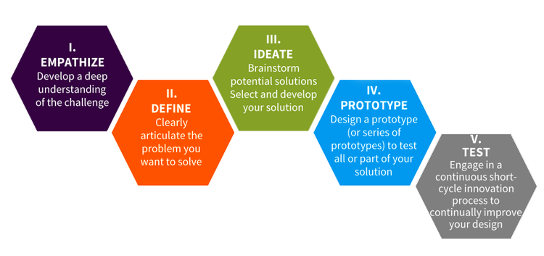
Emma Bourassa Foundations of Intercultural Communication
Constructivist orientation – students have varying understanding of what their own cultural values are and probably less understanding of the academic culture they are engaging. Students need support to see differences, and practice with different expectations to transition with less stress.
Design thinking approach
Notes:
Define problem and purpose: Students taking both EAL an academic courses at the same time do not automatically grasp the differences in the educational culture in a Canadian context- multiple assignments, group work, various assignments to earn marks,. Purpose is to have students understand themselves as cultural beings and placing that orientation into this Canadian context so they can understand where they might struggle and be able to ask for the help they need.

Slide 2
Imagine- Ideate
Self awareness
Learning outcomes
Theory
Culture-what is it?
Self as cultural being
gender, workplace,generational,
theoretical
the many cultural possibilities
Intercultural
7
dimensions
intersections:exploring
culture
Models
Models
Geert
Hofstede
Awareness , Sensitivity,Competency
Intercultural communication
Awareness, Sensitivity, Competency
7
dimensions
exercises
Fons
Trompenaars
Edward T. Hall
assignments
Notes:
Imagine (Ideate): The visual teased out foundational ideas of intercultural interactions including awareness in red, theory above in blue, self reflection in orange, models in purple below.
The 4 arms that work in a spiral design where students revisit concepts and expand their understanding of their own cultural norms and values and that of this context.

Slide 3
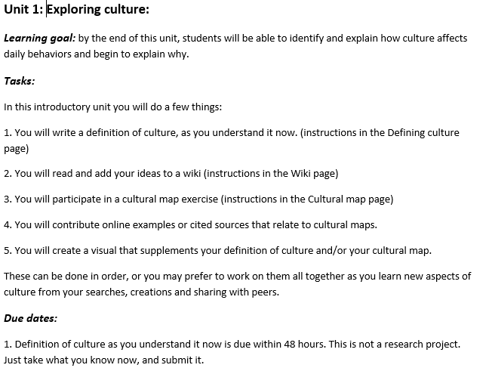
Notes:
Develop something to test (prototype) : Decided to start with the concept of culture- a needs assessment for me and a concept that underpins the whole course.
Test on sample audience: Setting up the students with an overview of course- Empathizing with students: Being very explicit and providing repetition reinforces terms and expectations
Experimenting with experiential/active learning :
Next round I included humour in online interactions because of a misunderstanding that could have gone very wrong

