Slide 1
Welcome to our wrapup!
Please note!
This session will be recorded
Check your sound while you’re waiting…
Hook up your headset
Choose your audio source
Choose your video source
Un collapse the side panel and say “Hi” in the chat area

Slide 2
Agenda
“Outside my window” check-in
“Mindmap Dotmocracy” looking back/looking forward activity
Our Course Experience - thinking about course experience on two different “tracks”
Open Mic
Notes:
Beth

Slide 3
“Outside your window”
Look outside your window (or imagine if you do not have a window) and share this verbally.
Notes:
Ross

Slide 4
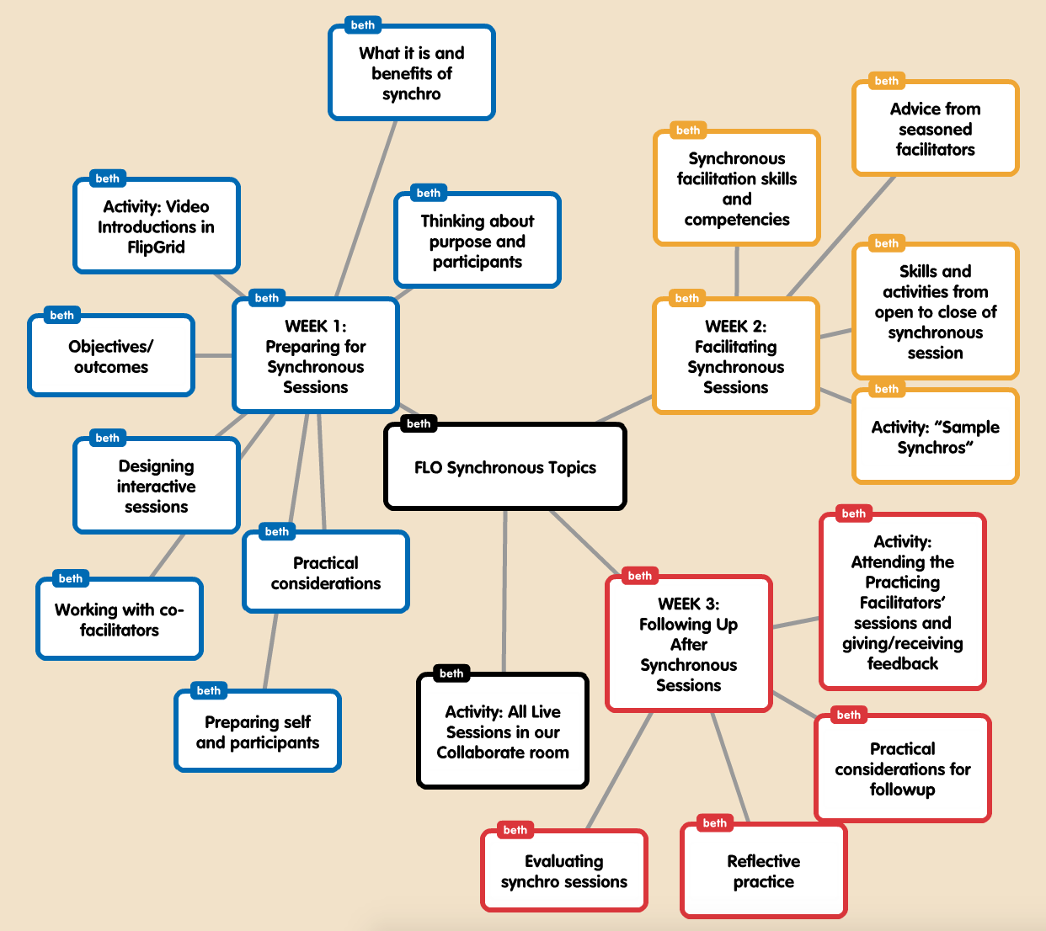
Mindmap Dotmocracy
-Circle the course topics/activities you really thought were key
-Put an X by the ones you could have used more of or want to keep learning about
Notes:
Beth

Slide 5
Our Course Experiences
Reviewing Participants
Practicing Facilitators
Notes:
Ross

Slide 6
Open Mic
What worked with the design of the course? What didn’t work as well as it could have?
eg. course length, weekly themes, two “tracks”
What could you have used in terms of technical skills know-how before the start of this course, if anything?
If you had designed this course, what might you have done differently?
Anything else you want to mention 😃
image by Bragg’s Untrained Eye on Flickr, Creative Commons attribution
Notes:
Beth and Ross both

Slide 7
Hooray!
Final questions?
Thank you all!
image by kacos2000 on Flickr, Creative Commons attribution
Notes:
Ross – note final deliverables by Sunday (self-assessment rubric, course feedback)

