Slide 1
Welcome to Week 2!
Please note!
This session will be recorded
Check your sound while you’re waiting…
Hook up your headset
Choose your audio source
Choose your video source
Un collapse the side panel and say “Hi” in the chat area

Slide 2
Agenda
Brief check in with everyone
Discuss goals related to synchronous online facilitation using a Liberating Structure process, and using breakout rooms
Give some people a chance to practice moderator tasks
Debrief the process in a “fishbowl” setting

Slide 3
Check In
Post one word that describes how you’re feeling this week | Post one word that someone would use to describe you in general

Slide 4
Activity: 1-2-4-All
Invitation: Looking at the Facilitation Session Guide and the criteria stated there, which of them are most important to you to develop in order to facilitate synchronous sessions?
Overview of Process:
Reflect on own (1 min)
Move to breakout rooms in pairs according to chart and discuss (4 min)
Come back to the main room when the timer goes
Move to breakout rooms in fours according to chart and discuss (8 min)
Come back to main room when the timer goes
Whole group debrief (8 min)

Slide 5
STEP 1: INDIVIDUAL REFLECTION (1 min)
On your own, quietly reflect and take notes on the following question:
Looking at the Facilitation Session Guide and the criteria stated there, which of them are most important to you to develop in order to facilitate synchronous sessions?

Slide 6
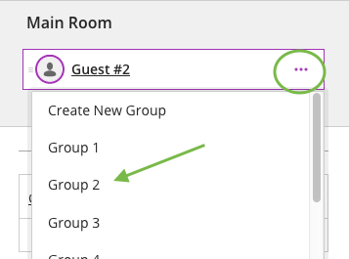
STEP 2: PAIRS DISCUSSION (4 min)
In your breakout room, as a pair, debrief your individual reflections around the invitation question:
Looking at the Facilitation Session Guide and the criteria stated there, which of them are most important to you to develop in order to facilitate synchronous sessions?

Slide 7
STEP 3: FOURS DISCUSSION (8 min)
In your breakout room, in your foursome, do the following:
Each person choose one thing on their pairs list to briefly share
Make sure everyone gets a chance to share
Room | Four
1
2
3
4
5
6

Slide 8
STEP 4: GROUP DISCUSSION (8 min)
Pick up the mic to talk!
Highlights from your discussions? Which skills are most valuable to you to develop? Further questions or comments?
Image by reynermedia on Flickr, CC

Slide 9
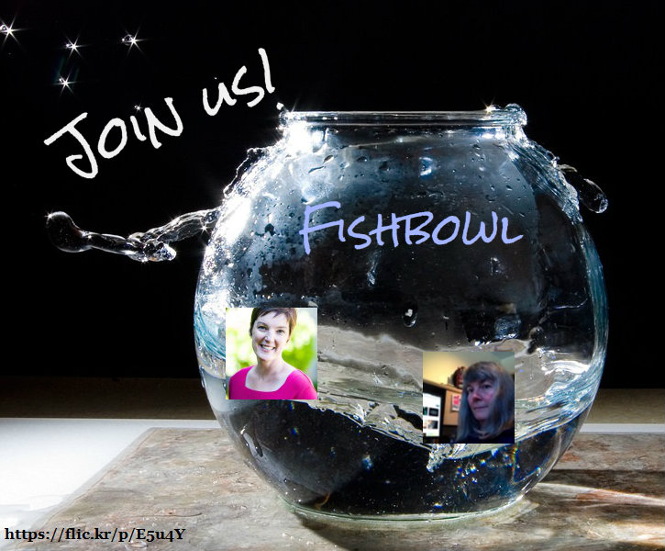

Slide 10
Write your name beneath a chair
and get comfortable!
What went well?
What could have gone differently?
What questions does it bring up for you about facilitating your sessions?

Slide 11
Session Close
Thank you!
Any final questions?

