Slide 1
Welcome to the FDO!
While you’re waiting…
Please run the audio setup wizard
Facilitators’ Development Workshop – MaY 2015
Kickoff Session
This session will be recorded…

Slide 2
Agenda
Intros & Tech Check
Quick Collaborate Warm-up
FDO Site check-in
Journals
Collecting Your Questions
Facilitator Discussion Questions

Slide 3
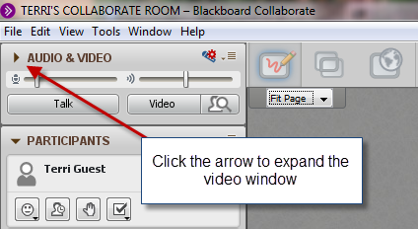
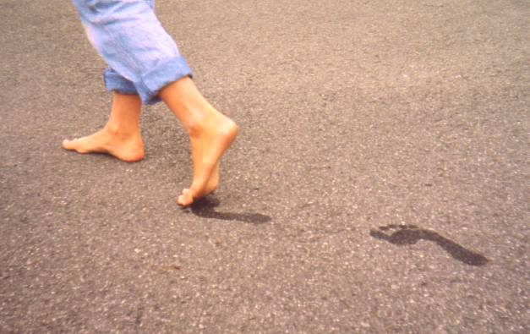
Intros & Tech Check
Who and where are you?
Tell us about your FEET!
What are you wearing on your feet?
Where do your feet take you?
Use sliders to adjust volume
http://en.wikipedia.org/wiki/File:Healthy_feet.JPG
Click to talk, click when finished

Slide 4
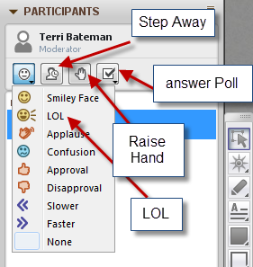
Quick Collaborate Warm-up
What kind of a day is it for you, so far?
Are you happy and you know it?
Have you looked around the FDO course site already? (Yes or No )
When did you last moderate a live web conferencing session?
Earlier today
Last week
A month or more
Never

Slide 5
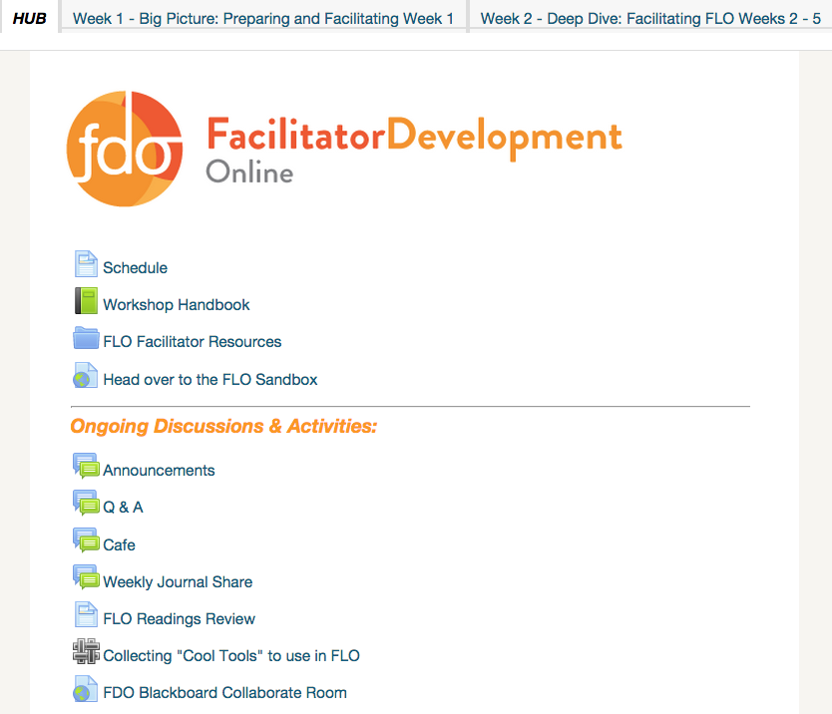
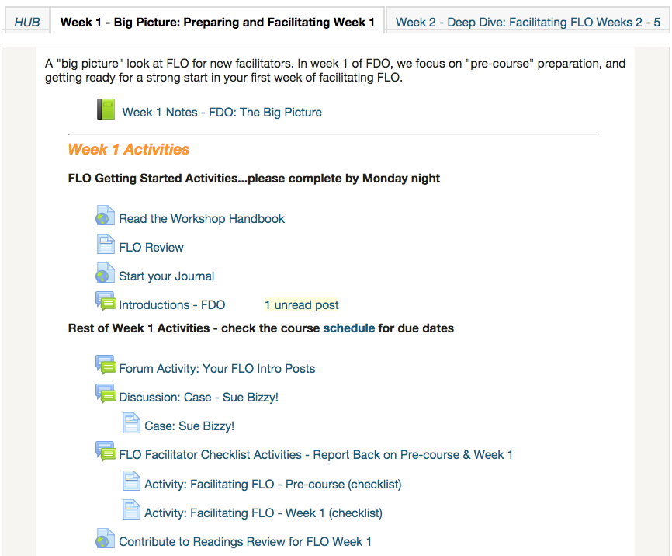

Slide 6
Your Learning Journal…
What format did you use in FLO?
What Format will you use in FDO?
Paper
Blog
Word doc
Google doc
Evernote
Other (what was it? Type it in…)
Paper
Blog
Word doc
Google doc
Evernote
Other (what will it be? Type it in…)

Slide 7
Collecting Your Questions
What specific questions do you need answers to?
What specific issues do you want to discuss?

Slide 8
Facilitator Discussion: How messy should learning be?
“I’m so frustrated”
“I’m going to withdraw. This is overwhelming”
“It was SO MUCH WORK but we did it!!!”

Slide 9
Facilitator Discussion: Balancing tech, design, and FACILITATION
How much of the FLO should be about using technologies outside of the LMS?
Is suggesting that participants design an activity too much?

Slide 10
Facilitator Discussion: Adjusting on the fly
Sometimes, enrolment doesn’t work out exactly as you’d hope (i.e., exactly 8-10 people).
How to adjust for high/low numbers?
What is the impact of attrition on participants? On the FLO facilitators?

Slide 11
Facilitator Discussion: Is there a better way to do X?
“Cool Tools” in FLO and FDO – Moodle wiki or glossary, external wiki? (what’s the ideal approach?)
What else…

Slide 12
Facilitator Discussion: Work-Life Balance Topic
What are your perspectives? Is it worth doing?
How? As a mini-session?

