Slide 1
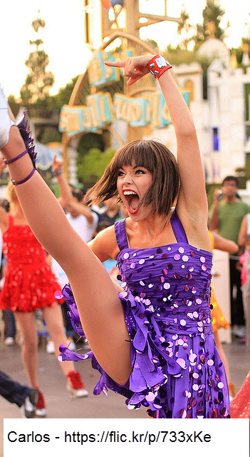
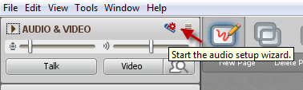
FLO Celebration!
While you’re waiting…
Please run the audio setup wizard
celebration and Wrap-up Session

Slide 2
Who made it?
Notes:
Insert profile images and names of final participants

Slide 3


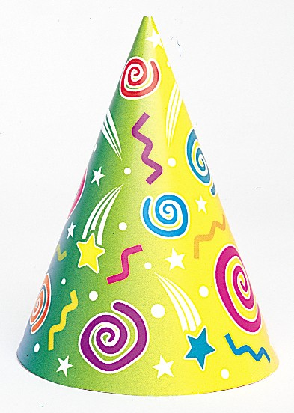
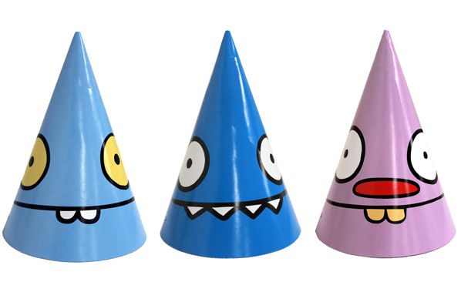
Notes:
Encourage everyone to pick a party hat for the celebration

Slide 4
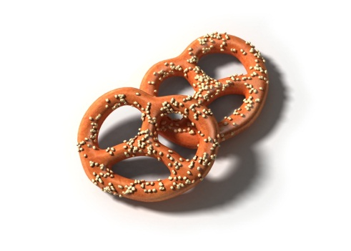
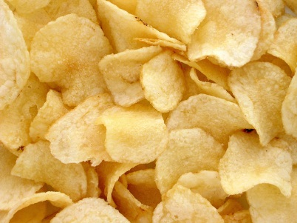
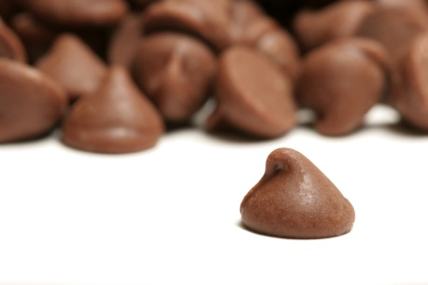
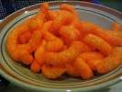
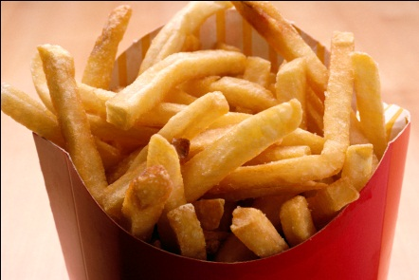
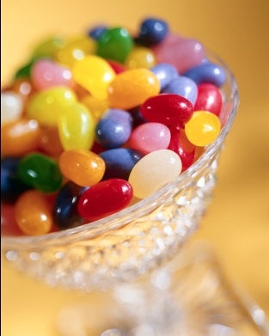
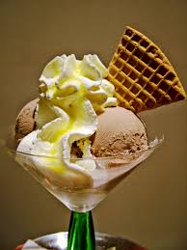
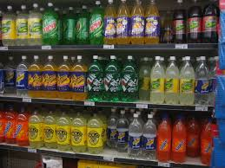

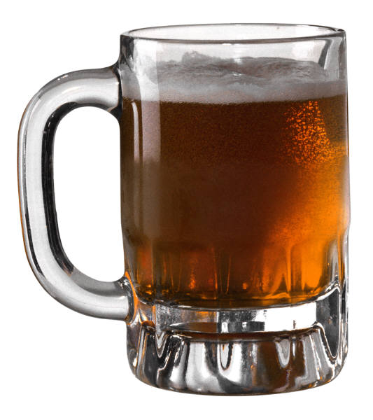
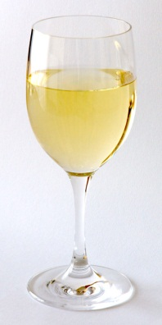
Notes:
http://health.howstuffworks.com/mental-health/human-nature/perception/taste2.htm
Pick a snack/treat/drink for the celebration

Slide 5
Week 1: Community
1. Who is a social artist and eats oranges and fortune cookies?
2. Who is the self-described “serious individual” who works on a big hill?
3. Who is an enthusiastic munchkin wrangler and a Prezi-princess?
4. Who is a slave to her cat and recently completed a dinosaur MOOC?
Notes:
Review their Introductions and create a mini-quiz to see how well they know each other now
Update questions

Slide 6


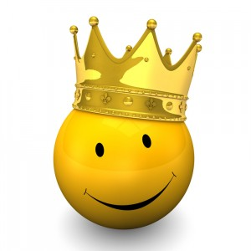
Notes:
Successful guesses get to pick their award

Slide 7
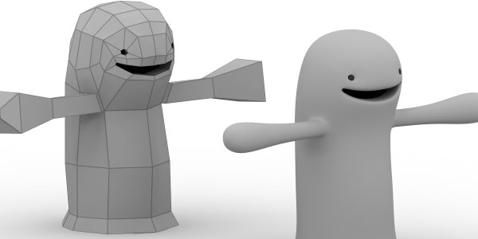
Week 2: Adult Learners Online
Notes:
Quick review of our experiences doing the demo – review any funny feedback or really cogent comments

Slide 8
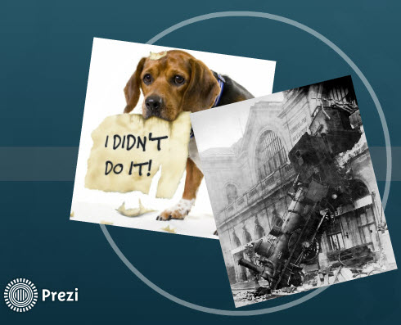

Week 3: Dueling Mini-sessions
Notes:
Choose Your Tools and Course Review Task Force – replace image of Vivianna’s mini-session submission for Course Review Task Force
If mini-session facilitators are present, ask them to briefly share “nuggets” from their experience (otherwise be prepared to share something for them)

Slide 9
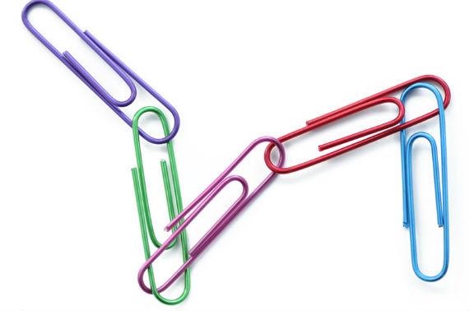
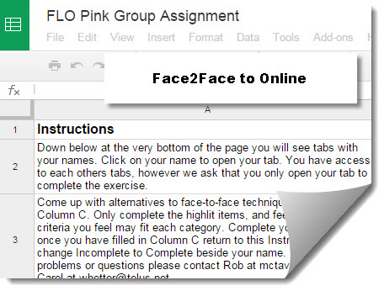

Week 4: Sessions in Sync
Team in Trouble Case Study
Notes:
Replace image of Pink session – If mini-session facilitators are present, ask them to briefly share “nuggets” from their experience (otherwise be prepared to share something for them)

Slide 10


Assessing Participation
FLO
Notes:
Review this image if the session was focused generally on Assessment rather than on the FLO Rubric and Assessment of Participation

Slide 11
Looking Back
FLO course was that it was a safe place to
make mistakes and learn from my mistakes
I have gained a new confidence in my ability to learn
Enjoyed discussing pedagogy and online design with new colleague
Key learnings came in discussions with FLO members
Affirmed some of my practices.
Appreciated feedback about different levels of comfort with technology
Notes:
Final reflective activity – pull out some quotations from final submissions – Looking Back

Slide 12
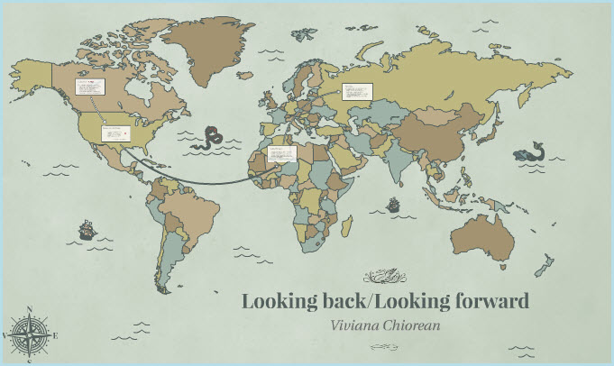
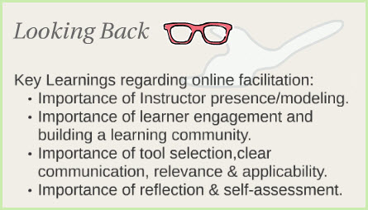
Key Learnings

Slide 13
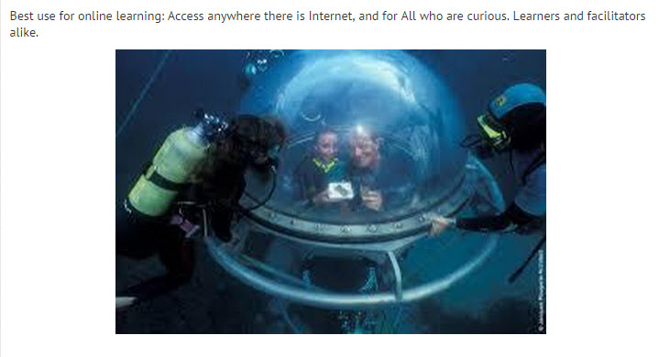
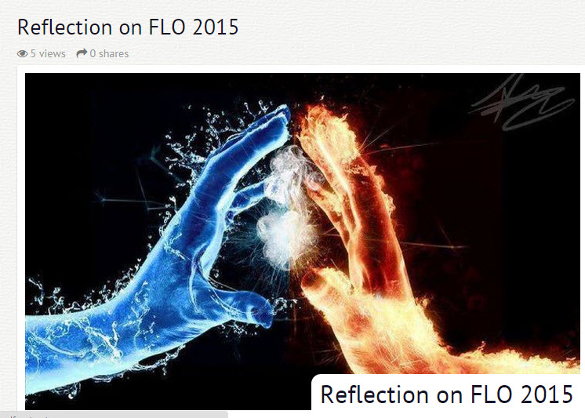
Notes:
Update with images from current FLO’s Looking Back, Looking Forward submissions

Slide 14
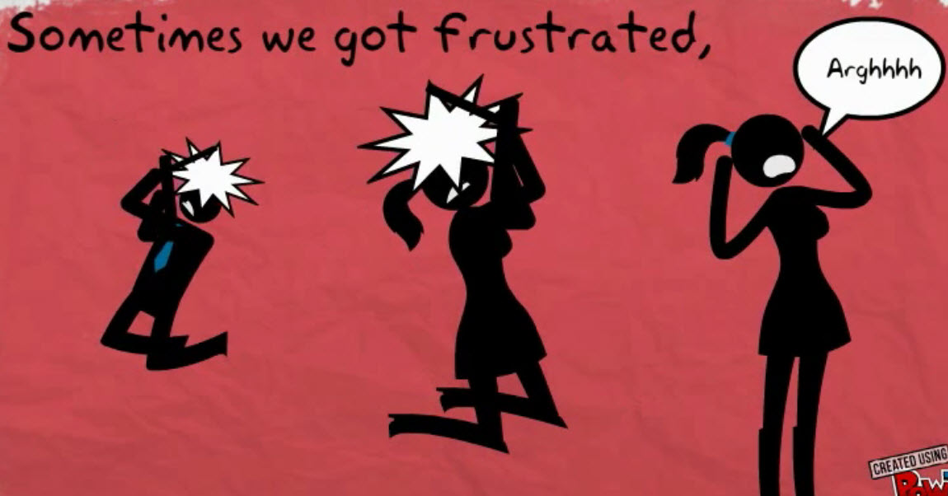
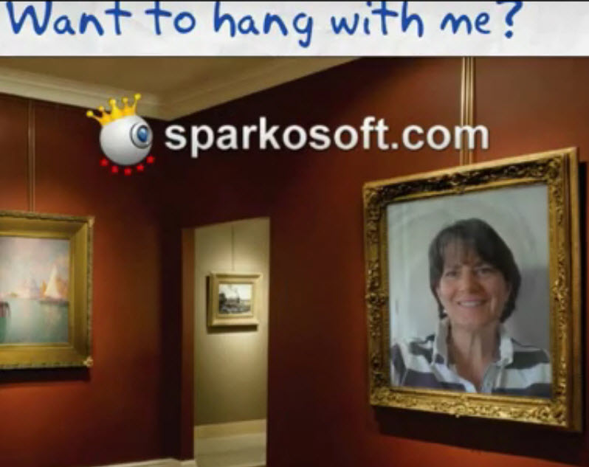

Slide 15
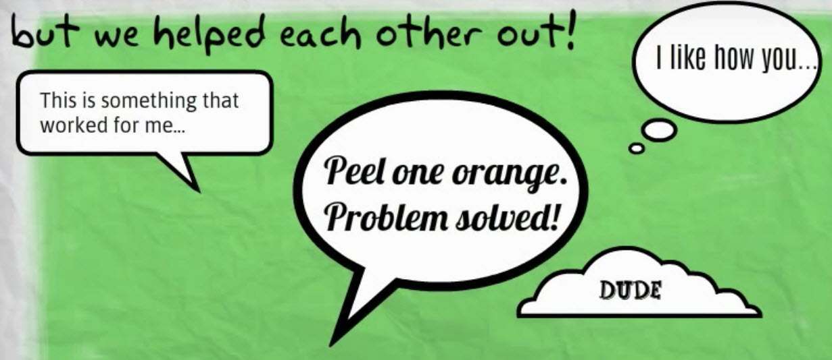

Slide 16
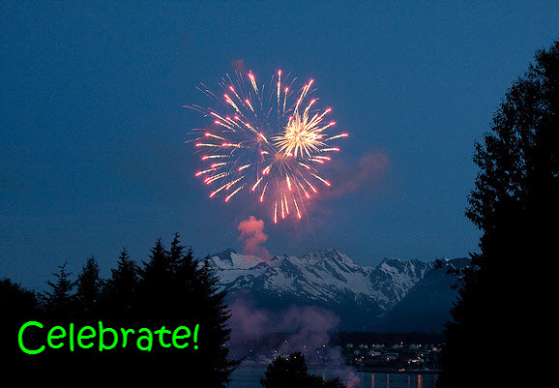


Notes:
My fireworks image – Haines, Alaska
Talk about what badges represent – they’ll receive their final certificates in the mail

