Slide 1
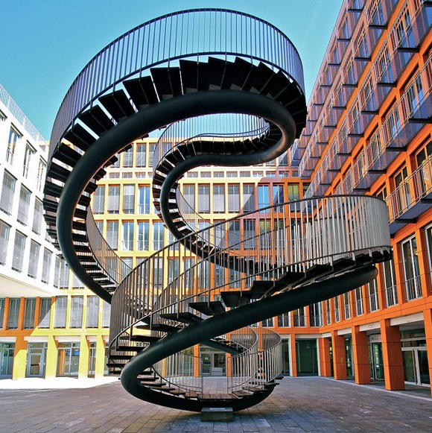
Intercultural Fluency:
A Lifelong Commitment

Slide 2
Selkirk College Context
300 % increase in international enrolments in 3 years
enrolments across campuses and 20 programs
pressure points for students, staff and communities

Slide 3
External Context - Provincial
By 2022 there will be 1M job openings in B.C. --- less than 600,000 residents will enter the workforce --- a gap of 400,000 jobs
In 2011, Ministry of Advanced Education required a 50% increase in international enrolments over 5 years in the B.C. post-secondary system

Slide 4
External Context – International
Australia and the United Kingdom have been aggressively addressing the international market
Developing resource packages for institutions
Recruiting international students
Establishing international educational partnerships

Slide 5
Rationale for Internationalization
Domestic students need to learn how to live and work in a global environment
Even our local region needs immigration for economic stability – international fees
A truly global education will benefit all our students and have a positive impact on our communities

Slide 6
Work to Date @ Selkirk
Discovery Day (Feb 2015) – Kyra Garson keynote and workshops in inter-cultural fluency
Learning at Intercultural intersections' (Mar 2015, TRU) – 7 people from Selkirk attended
Dialogue (Apr 2015) – day-long with about 40 Selkirk staff/instructors
BootCamp (September 2015) – ½-day introduction for Selkirk staff
Ongoing Learning Cohort– 20 staff
Program Outcome Process
Strategic Plan – Advisory Committee incl. external

Slide 7
Dialogue Themes
Instructional Strategies
Expectations and Agreements
Authentic Voice
Critical Thinking
Intercultural Fluency
Technology as a Strategy
Literacy and Culture
Peer Mentoring and Teaching
Evaluation and Assessment

Slide 8
Dialogue Themes
Infrastructure
Staff Education
New Approaches (Bridging)
Orientations
Student Supports
Socialization and Globalization of Students

Slide 9
Mindset Activity
Group reads mindset
List advantages and disadvantages to THIS person
Well-known person or phrase that describes this mindset

Slide 10
Your Mindset
Group D
You have experienced a culture other than your own that has influenced your thinking. Your experience with other cultures has made you realize another view of your own culture, which is sometimes less than rosy. You realize that your own culture has numerous imperfections and may even be responsible for the problems it experiences or incurs.
You are a champion of the new culture(s) you have experienced and are somewhat cynical about the historical interactions of your culture with them. You have a deep respect for the richness of other cultures and feel that your own culture lacks in comparison. When members of the culture you admire make negative comments about your culture, you realize how inferior it really is.
Your clear strength is the ability to be aware of your own culture’s influence on your thinking and to disavow that mentality in order to set things on the right path. You may find yourself championing the culture of others while members of your own culture group don’t seem to understand.

Slide 11
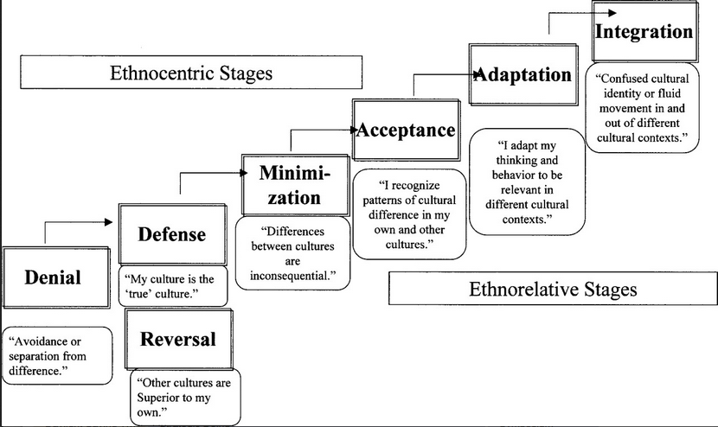

Slide 12
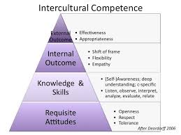
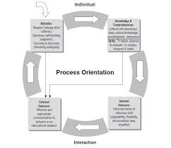
Changing Models
From: Deardorff, Darla K. "Identification and assessment of intercultural competence as a student outcome of internationalization." Journal of studies in international education 10.3 (2006): 241-266.

Slide 13
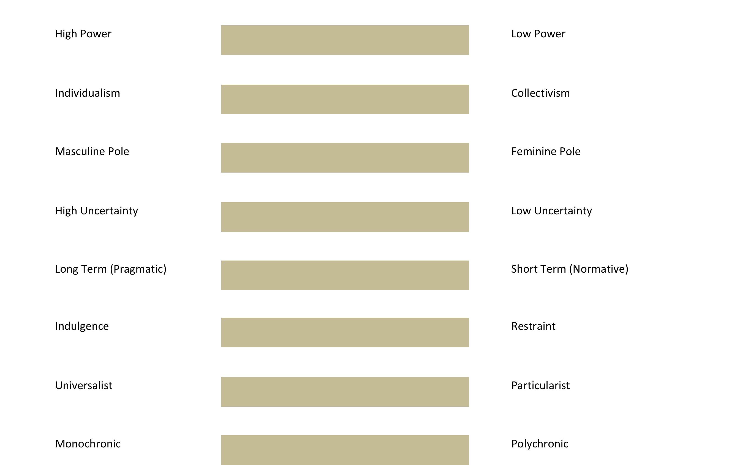

Slide 14
Description of the DMIS:
The Development Model of Intercultural Sensitivity. https://scope.bccampus.ca/pluginfile.php/18301/mod.../DMIS.pdf
Description of the IDI:
Hammer, M. R., Bennett, M., & Wiseman, R. (2009). The intercultural development inventory.
https://idiinventory.com/wp-content/uploads/2013/08/HAMMER-STUDY-ABROAD-ARTICLE-2012.pdf
Resource List:
Internationalization of the Curriculum, Queens University. http://library.queensu.ca/webedu/grad/Internationalization_of_the_Curriculum.pdf

Slide 15
Thanks for your participation!
Theresa Southam
Coordinator, Teaching and Learning Institute
tsoutham@selkirk.ca
SELKIRK PUBLIC WEBSITE: http://selkirk.ca/research/tli
MY SELKIRK: https://my.selkirk.ca/staff/dept/teachinglearninginstitute/
ALSO Join the Teaching and Learning Institute on
Twitter: https://twitter.com/SelkirkTLI
Facebook: https://www.facebook.com/SelkirkTLI
YouTube: https://www.youtube.com/user/theresagerrard

Slide 16
Thank You!
Are there any questions or comments?

