Slide 1

CURRICULUM

Slide 2
Here’s how it works:
Each person (or each team) will receive 5 index cards
Number your cards (write big) 1 – 5
We will be presenting you with a number of theories & ideas that often influence our curriculum development and instructional design work. For each theory we present, we’ll ask you: “How comfortable are you with this theory/idea/statement?” or “To what degree to you agree with this theory/idea/statement?”
Each person (or team) should hold up a “1” if you are “very unagreeable”, a “5” if “very agreeable”, or something in between.

Slide 3
Theory #1: Learning Styles
People vary widely in terms of their learning styles. While some are visual learners who learn best by reading and seeing, others are auditory learners who learn best by listening and speaking. Still others favour a kinesthetic learning style. Since students perform better when they receive instruction in their preferred learning style, curriculum developers should attempt wherever possible to design instruction that accommodates a variety of learning styles.

Slide 4
Theory 1: Agree or disagree?
How confident are you in the theory of Learning Styles? Hold up card #5 if you are very confident, or card #1 if you barely believe it.
Or something in-between if you’re not 100% sure either way

Slide 5

Theory 1: The evidence
“Learning styles theory, despite its continued popularity, has failed to produce sufficient evidence of being a valuable educational tool. By focusing on teaching to students’ strengths this approach misses an important opportunity to encourage students to work on developing their weaknesses as well.”
http://www.skeptic.com/insight/the-myth-of-learning-styles/

Slide 6
Theory 1: for more information
Hard research: http://www.apa.org/pubs/journals/features/edu-a0037478.pdf
Beth A. Rogowsky, B.A.; Calhoun, B.M.; Tallal, P. (2015). Matching Learning Style to Instructional Method: Effects on Comprehension. Journal of Educational Psychology, 107(1). Pp. 64–78

Slide 7
Theory 1: What should we do instead?
[your thoughts go here]

Slide 8
Theory #2: Spaced repetition
Spaced repetition is a learning technique that incorporates increasing intervals of time between subsequent review of previously learned material in order to exploit the psychological spacing effect. It is especially useful in contexts in which a learner must memorize and retain a large number of items, such as vocabulary acquisition in second language learning, or the learning of medical terminology.
Adapted from: https://en.wikipedia.org/wiki/Spaced_repetition

Slide 9
Theory 2: Agree or disagree?
How confident are you in the theory of Spaced Repetition? Hold up card #5 if you are very confident, or card #1 if you barely believe it.
Or something in-between if you’re not 100% sure either way

Slide 10

Theory 2: The evidence…
…is extensive. Research on this started in the 1930’s; several comprehensive studies yielded fairly consistent results
Pimsleur (of the Pimsleur language learning system) is one of the most famous advocates. For the acquisition of second language vocabulary, he recommended intervals of: 5 seconds, 25 seconds, 2 minutes, 10 minutes, 1 hour, 5 hours, 1 day, 5 days, 25 days, 4 months, and 2 years.
With the advent of computers, intervals can be optimized for individual learners.

Slide 11
Theory 2: for more information
Balota, D., Duchek, J. & Logan, J. Chapter 6: Is Expanded Retrieval Practice a Superior Form of Spaced Retrieval?, A Critical Review of the Extant Literature. From: http://www.psych.wustl.edu/coglab/publications/Balota+et+al+roddy+chapter.pdf
Pimsleur, P. (1967). "A Memory Schedule". The Modern Language Journal (Blackwell Publishing) 51 (2): 73–75.

Slide 12
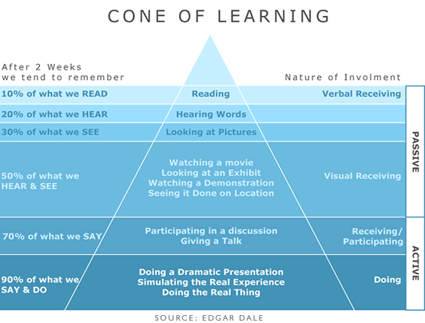
Theory #3: Dale’s Cone of Experience
Dale’s Cone of Experience (sometimes labelled a ‘Cone of Learning’) shows graphically how different types of learning activities (reading vs. watching vs. active participation) affect our ability to learn deeply and remember.
http://willthalheimer.typepad.com/.shared/image.html?/photos/uncategorized/coneoflearning_1.gif

Slide 13
Theory 3: Agree or disagree?
How confident are you in Dale’s Cone of Experience? Hold up card #5 if you are very confident, or card #1 if you barely believe it.
Or something in-between if you’re not 100% sure either way

Slide 14
Theory 3: The evidence
“…Dale's "Cone of Experience," developed in 1946 by Edgar Dale … provided an intuitive model of the concreteness of various audio-visual media. Dale included no numbers in his model and there was no research used to generate it. In fact, Dale warned his readers not to take the model too literally.”
However “The numbers presented on the graph have been circulating in our industry since the late 1960's, and they have no research backing whatsoever.” http://www.willatworklearning.com/2006/05/people_remember.html

Slide 15
Theory 3: What should we do instead?
[your thoughts go here]

Slide 16
Theory #4: Student-student Interactivity
Learning – almost by definition – involves a learner interacting with a learning experience. Learners may interact with the content, the instructor, and fellow students, but it is this third type of interaction (interaction with other students through collaboration, small group work, etc.) that yields the strongest learning gains. This remains true across a wide variety of disciplines and deliveries (online, blended, face-to-face).

Slide 17
Theory 4: Agree or disagree?
How confident are you in the critical importance of student-student interaction? Hold up card #5 if you are very confident, or card #1 if you barely believe it.
Or something in-between if you’re not 100% sure either way

Slide 18
Theory 4: The evidence
Anderson’s Equivalency Theorem (2003) has been widely used as a basis for challenging the supremacy of student-student interaction in distance & online learning. The first part of this theory states: “Deep and meaningful formal learning is supported as long as one of the three forms of interactions (i.e., student–teacher, student–student, and student–content) is at a high level. The other two may be offered at minimal levels, or even eliminated, without degrading the educational experience.”

Slide 19
Theory 4: for more information
Anderson, T. (2003). Getting the mix right again: An updated and theoretical rationale for interaction. The International Review of Research in Open and Distance Learning, 4(2), from http://www.irrodl.org/index.php/irrodl/article/view/149/230 .

Slide 20
Theory 4: What should we do instead?
[your thoughts go here]

Slide 21
Theory #5:
Common-sense vs. the ‘Wizard of Oz’ treatment
As teaching and learning specialists, our curriculum development work will benefit from a combination of approaches, including both clinical (learning from personal experience/praxis and reflection) and evidence-based (learning from the experience of others, especially rigorous research).

Slide 22
Theory 5: Agree or disagree?
(This one is easy ☺). When informing our curriculum development/ instructional design work:
Hold up card #5 if you think evidence-based approaches, including input from rigorous research, are most important
Hold up card #1 if you believe clinical (our own & our colleagues’ experiences) are most important
Hold up card #3 if you think both approaches should inform our practice.

Slide 23

Theory 5: Discussion

Slide 24
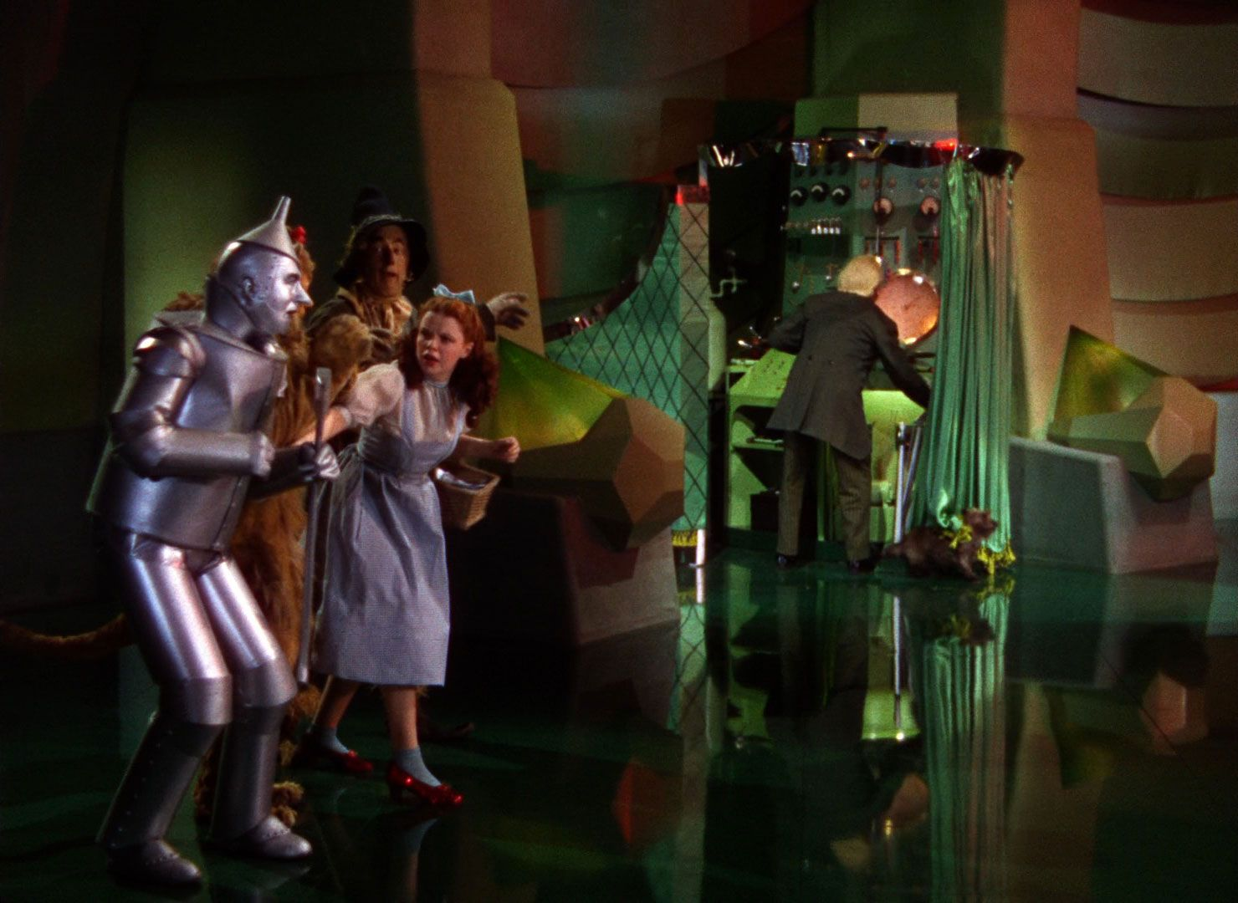
Theory 5:
Don’t forget the Wizard of Oz treatment
Even well-established ‘rules’ of good instructional design are not necessarily based on evidence. Sometimes we actually need to look behind the curtain to verify claims.

