Slide 1
UFV FLO June 15 Course

Slide 2
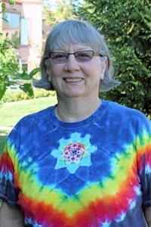
Welcome to the UFV FLO Course
Upgrading and University Prep Department
Faculty of Access and Continuing Education
Canada Education Park Campus,
Chilliwack, BC
Leonne Beebe

Slide 3
I use Blackboard Learn tools to “tech enhance” my multi-level Fundamental Math Courses.
Class Announcements
Individual Review and Reflect Journals
Collaborative Group Discussions
Teacher Full Grade Centre
Student Full Grade Centre
I also use the Blackboard Learn tools to collect and store research data on journals and discussions.

Slide 4
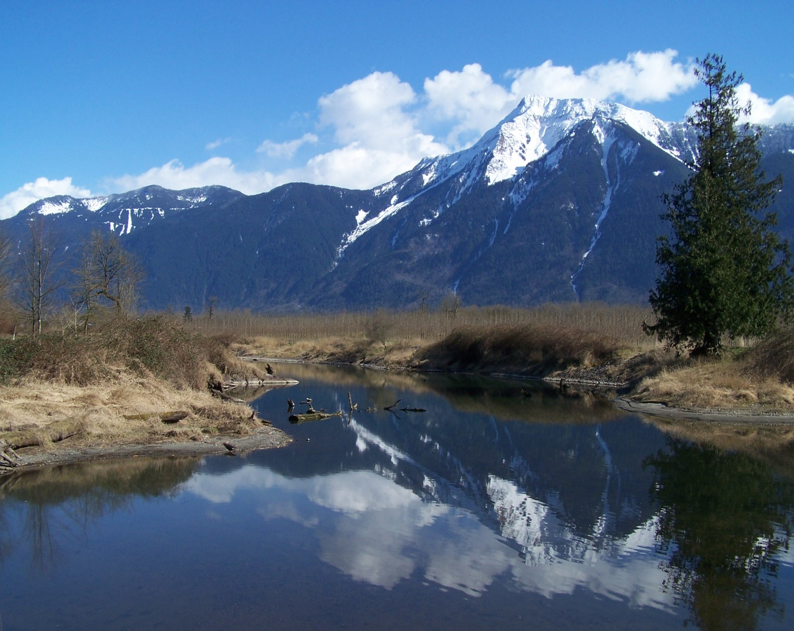
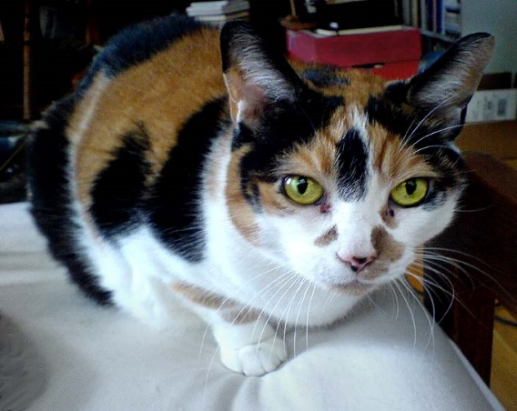
Walking past my home with my cat, Callie, I see this view of Mt. Cheam near Agassiz.
Callie

Slide 5
These are my favourite sayings I share with my students.
Source: http://www.aseire.com/index/you-never-know-who-s-listening

Slide 6
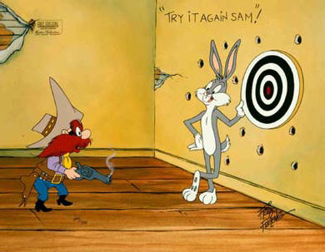
“Try has NO power. Do has NOW power.”
Source: Bing on-line pictures

Slide 7
“Worrying is like a rocking chair. It keeps you busy, but it doesn’t get you anywhere.” Source: words - Erma Brombeck
Source: http://www.adamgonnerman.com/2009_11_01_archive.html

Slide 8
“Learning starts with confusion. Out of confusion comes clarity.
Source: https://lewismct.wikispaces.com/1A+Voc2

Slide 9
Enjoy your UFV FLO course
Please ask for
Please keep in touch
Leonne Beebe
Source: happy face - http://timesunlimited.blogspot.com/2012/09/r-u-ok.html
help - https://asd-hs.wikispaces.com/help+-+held; computer - http://blogdelosmaestrosdeaudicionylenguaje.blogspot.com/2014/01/arasaac-se-vuelve-presentar-los-premios.html

