Slide 1


This session will be recorded…
ISWO Week 1
While you are waiting…
Say hi in the text chat area
Run the Audio Setup Wizard (to ensure your mic works)

Slide 2
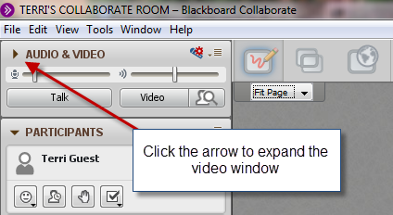




Intros & Tech Test
Name
Where are you? (briefly describe your surroundings using “5 senses” words)
5 Senses
I can see..
I can hear…
I can taste…
I can smell…
I can feel…
Use sliders to adjust volume
Click to talk, click when finished
Notes:
The purpose of this slide is to “get everyone in the room” by asking them about their surroundings and making sure their audio works.

Slide 3

Agenda
Collaborate Business:
  Quick tour/warm-up
  What you need to know about Collaborate in ISWO
  Recordings: discuss and decide re: access
ISWO Business
  Check in: How’s it going?
  Rubric for Participation self-assessment
  Journals
  Mini-sessions
Anything else?

Slide 4
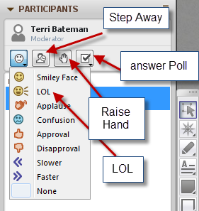
Collaborate: Let’s Play!
What kind of a day is it for you, so far?
The weather has been glorious today!
Have you used Collaborate or a similar tool before?
(Yes or No )
My favourite ISWO activity, so far:
  Everyone’s introductions
  Creating my journal
  Thinking about my mini-session
  Reading the readings
Notes:
The purpose of this slide is to ensure everyone knows how to use the basic participant feedback tools in collaborate

Slide 5

Whiteboard Tools
Try them ALL here, now!
Make open circles in your favourite colour
Play tic tac toe?
Type the name of your favourite book/movie
1 minute: GO!
Notes:
The purpose of this slide is to ensure people are able to write on the whiteboard – this prepares them for what comes next

Slide 6






Notes:
Ask participants to draw a circle (they have just learned/practiced in the previous slide) around the image that best represents how they feel about the ISWO, now. Do a bit of digging to find out more/why

Slide 7
Share…
Something GOOD I have heard, seen, read, tried, or thought about during week 1
Something I’m confused or uncertain about, right now…
Notes:
Ask participants to write on the white board under both of these headings. It will enable you to celebrate what’s good, and clarify any confusion or uncertainties they may be experiencing

Slide 8
Now that you’re warmed up…
What you need to know about Collaborate…
We are all moderators
The room is open 24/7 – link in the course
You are welcome to use it any time!
Recordings: Should we make all recordings available to all? (Yes or No )
Notes:
This slide emphasizes that they have access to the collaborate room and can use it any time, for whatever they want. Re: the question about recordings, groups vary on their comfort in this regard. If they say yes, make the link to the table of recordings available in the course site. If they say no, make another arrangement for them to get recordings from you if necessary

Slide 9
Participation Self-Assessment
Will you use the rubric provided? (Y/N)
Notes:
Participants indicate whether they will use the rubric provided. If they say no (indicating they will create their own), invite them to post/share online so others can see

Slide 10
Your Learning Journal
What format will you use?
Paper
Blog
Word Doc
Evernote
Other
Weekly Journal Share…
Notes:
Points to share:
when you take a course, go to a conference, etc, things get lost unless you jot them down which is why we’re asking you to keep a journal
From that, we are asking you to share 1-2 things so you don’t have to reveal whole journal, just 1-2 nugget per week.
This is a great way to connect what you are learning to the course you are working on
Keep your journal as a tool for your final “share” during the last week – it could end up having all the notes you need to bust out a new activity design or even a whole course

Slide 11

Mini-Sessions
Who? What? When?
Week | Topic | Facilitators
2 | Course Review Task Force | Put names of participants here (put name of co-facilitator who is supporting this group/topic here)
2 | Wiki Activity | Put names of participants here (put name of co-facilitator who is supporting this group/topic here)
3 | Duelling Tools | Put names of participants here (put name of co-facilitator who is supporting this group/topic here)
4 | Facilitating Team Work (Team in Trouble) | Put names of participants here (put name of co-facilitator who is supporting this group/topic here)
5 | Assessing Participation | Put names of participants here (put name of co-facilitator who is supporting this group/topic here)
Notes:
This is a review of the assignment of topics in the course. This info should also be available in the course schedule. Recommend that if anyone wants to switch, they work it out among themselves (they can post a note to the QA forum ) and let you know in the next day or 2.

Slide 12

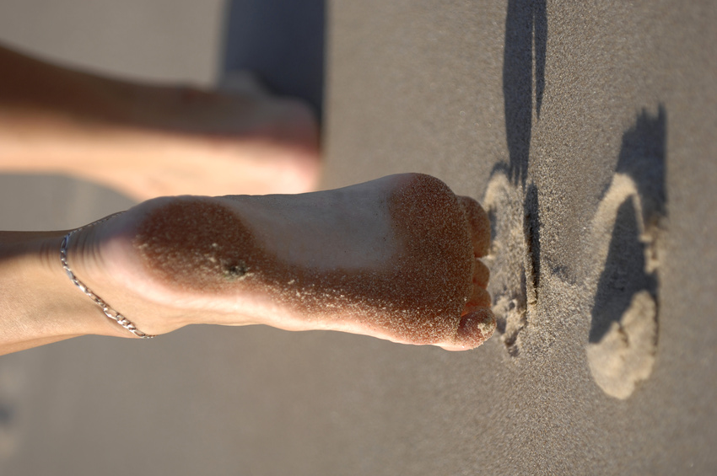
Mini-sessions…
Have you…(or do you know how to…)
Connected with your partner?
Found your “back pocket strategy”?
Been thinking about the learning outcomes you need to work with?
Got everything you need to move forward?
Notes:
This is a brief checklist to ensure people are reading to move forward with their mini-sessions. Remove any barriers as soon as possible.

Slide 13

Anything Else?

Slide 14

Thank you!

