Slide 1
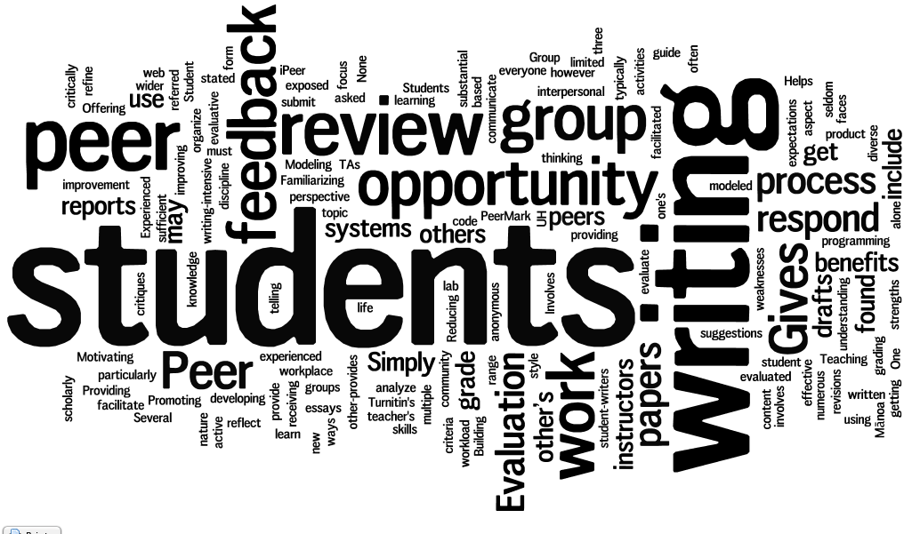
Improving Peer Review of Writing with Calibrated Peer Review
Andrea Han and Joanne Fox
andrea.han@ubc.ca joanne@msl.ubc.ca
Notes:
ANDREA
http://www.wordle.net/show/wrdl/5352878/What_is_peer_review

Slide 2
What is Peer Review?
Evaluating peer contributions to group work
Feedback/marking of a peer’s work
What is peer review?:
http://www.elearning.ubc.ca/toolkit/student-evaluation/
Notes:
ANDREA
http://www.mwp.hawaii.edu/resources/peer_review.htm#what
Simply stated, peer review involves sharing one's writing with a group of peer readers who offer feedback and suggestions for improvement.
http://www.elearning.ubc.ca/toolkit/student-evaluation/
Student peer review (also referred to as Peer Evaluation) is a process modeled after scholarly peer review. In this process students are asked to submit work (typically written) and then evaluate the work of their peers. Evaluation is often anonymous and facilitated through the use of rubrics. Evaluation may focus on writing, content or both. Peer review does not have to be limited to essays or reports, but could include a diverse range of activities such as programming code or lab reports.
Students synthesize, organize and communicate knowledge as they develop the product to be evaluated. While evaluating the work of their peers, students have the opportunity to be exposed to the work of others, explore new ways of thinking about a topic and both refine and reflect on their own understanding.
Several web based systems exist to facilitate student peer evaluation. At UBC, three such systems are:
Calibrated Peer Review (CPR)
iPeer
Turnitin's PeerMark

Slide 3
Do you currently use peer review? What has been your experience?
Notes:
ANDREA
Talk about challenge – ways to address… give example of idea, really looking for more ideas. Peer review PLoS example.

Slide 4
Benefits of Peer Review
Exposes students to their peers’ work
Models academic writing process.
Develops students' evaluative skills.
Formative feedback.
May decrease marking load for instructors.
May increase content mastered
Notes:
ANDREA
http://www.epa.gov/ncer/peerreview/
Nelson, L. (2003). Improving student peer feedback. College Teaching. 51 (1). http://cis.apsc.ubc.ca/wiki/images/2/28/Usj.pdf

Slide 5
Peer Review Challenges
Students
Fairness of peer marks
Uncomfortable
Unsure how to mark peers
Perception of value
Time commitment
Instructors
Quality of student feedback
Incorporation of student feedback
Dysfunctional group behavior
Questions about validity
Time commitment
Negative feedback
Notes:
ANDREA

Slide 6
SCIE113: First Year Seminar in Science
Format
Small group seminar (sections capped at 27)
Themes
Nature of Science
Writing
Writing intensive course
50 min sessions (M, W, F)
All sections merge biweekly for speakers
Scientific Argumentation & Evidence
Science & Society
Four in-class essays
Term paper (argumentative essay)
 | 2012-2013
Students | 438
Sections | 18
TAs | 7
Instructors | 16
Departments | Faculty from 11 departments
Notes:
JOANNE:
Script from 2011 Supper Series –
With SCIE113, We set out to create a course that gets students thinking about, “What is science?” and “Where does it fit in my life?”
Our goals included changing student’s attitudes towards and about science, exploring what it means to think like a scientist, and how to communicate like a scientist
Class size limited to 24-26 students, seminar meets three times a week.
Course content essentially explores two questions with students, “What is science?” and “Where does science fit in my life?”
The emphasis is on effective communication through evidence based argumentation skills.
Writing intensive course, fulfills communication requirement of BSc, open to all incoming FYS student not in coordinated scie or scieONE
More details available course content, learning objectives handout (1-2 available on each table)
We’ve also brought a copy of the syllabus and faculty binders for the course, if you’d like to take a look.
Seminar = unique course format for FYS science students at UBC
Another unique aspect of the course = science and society speaker series, goal broaden student views – expand students’ horizons so they think widely about their future and what they can do with a science degree

Slide 7
Tools for Peer Review
Calibrated Peer Review
http://cpr.molsci.ucla.edu/Home.aspx
PEAR
http://www.uoguelph.ca/peartool/
PeerMark
http://turnitin.com/en_us/features/peermark
peerScholar
http://www.pearsoned.ca/highered/peerscholar/
Blackboard Peer & Self Evaluation
http://www.blackboard.com/Learn
Notes:
JOANNE

Slide 8
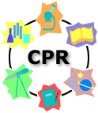
Free
Subscription
Notes:
JOANNE
UCLA – received NSF grant to develop tool peer review tool
Goal: enabling frequent writing assignments in large enrollment Chemistry courses without significantly increasing instructor workload
This version of the tool is still available for free online
Later additional funding from Howard Hughes Medical Institute to refine the tool – now subscription based used at over 700 institutions

Slide 9
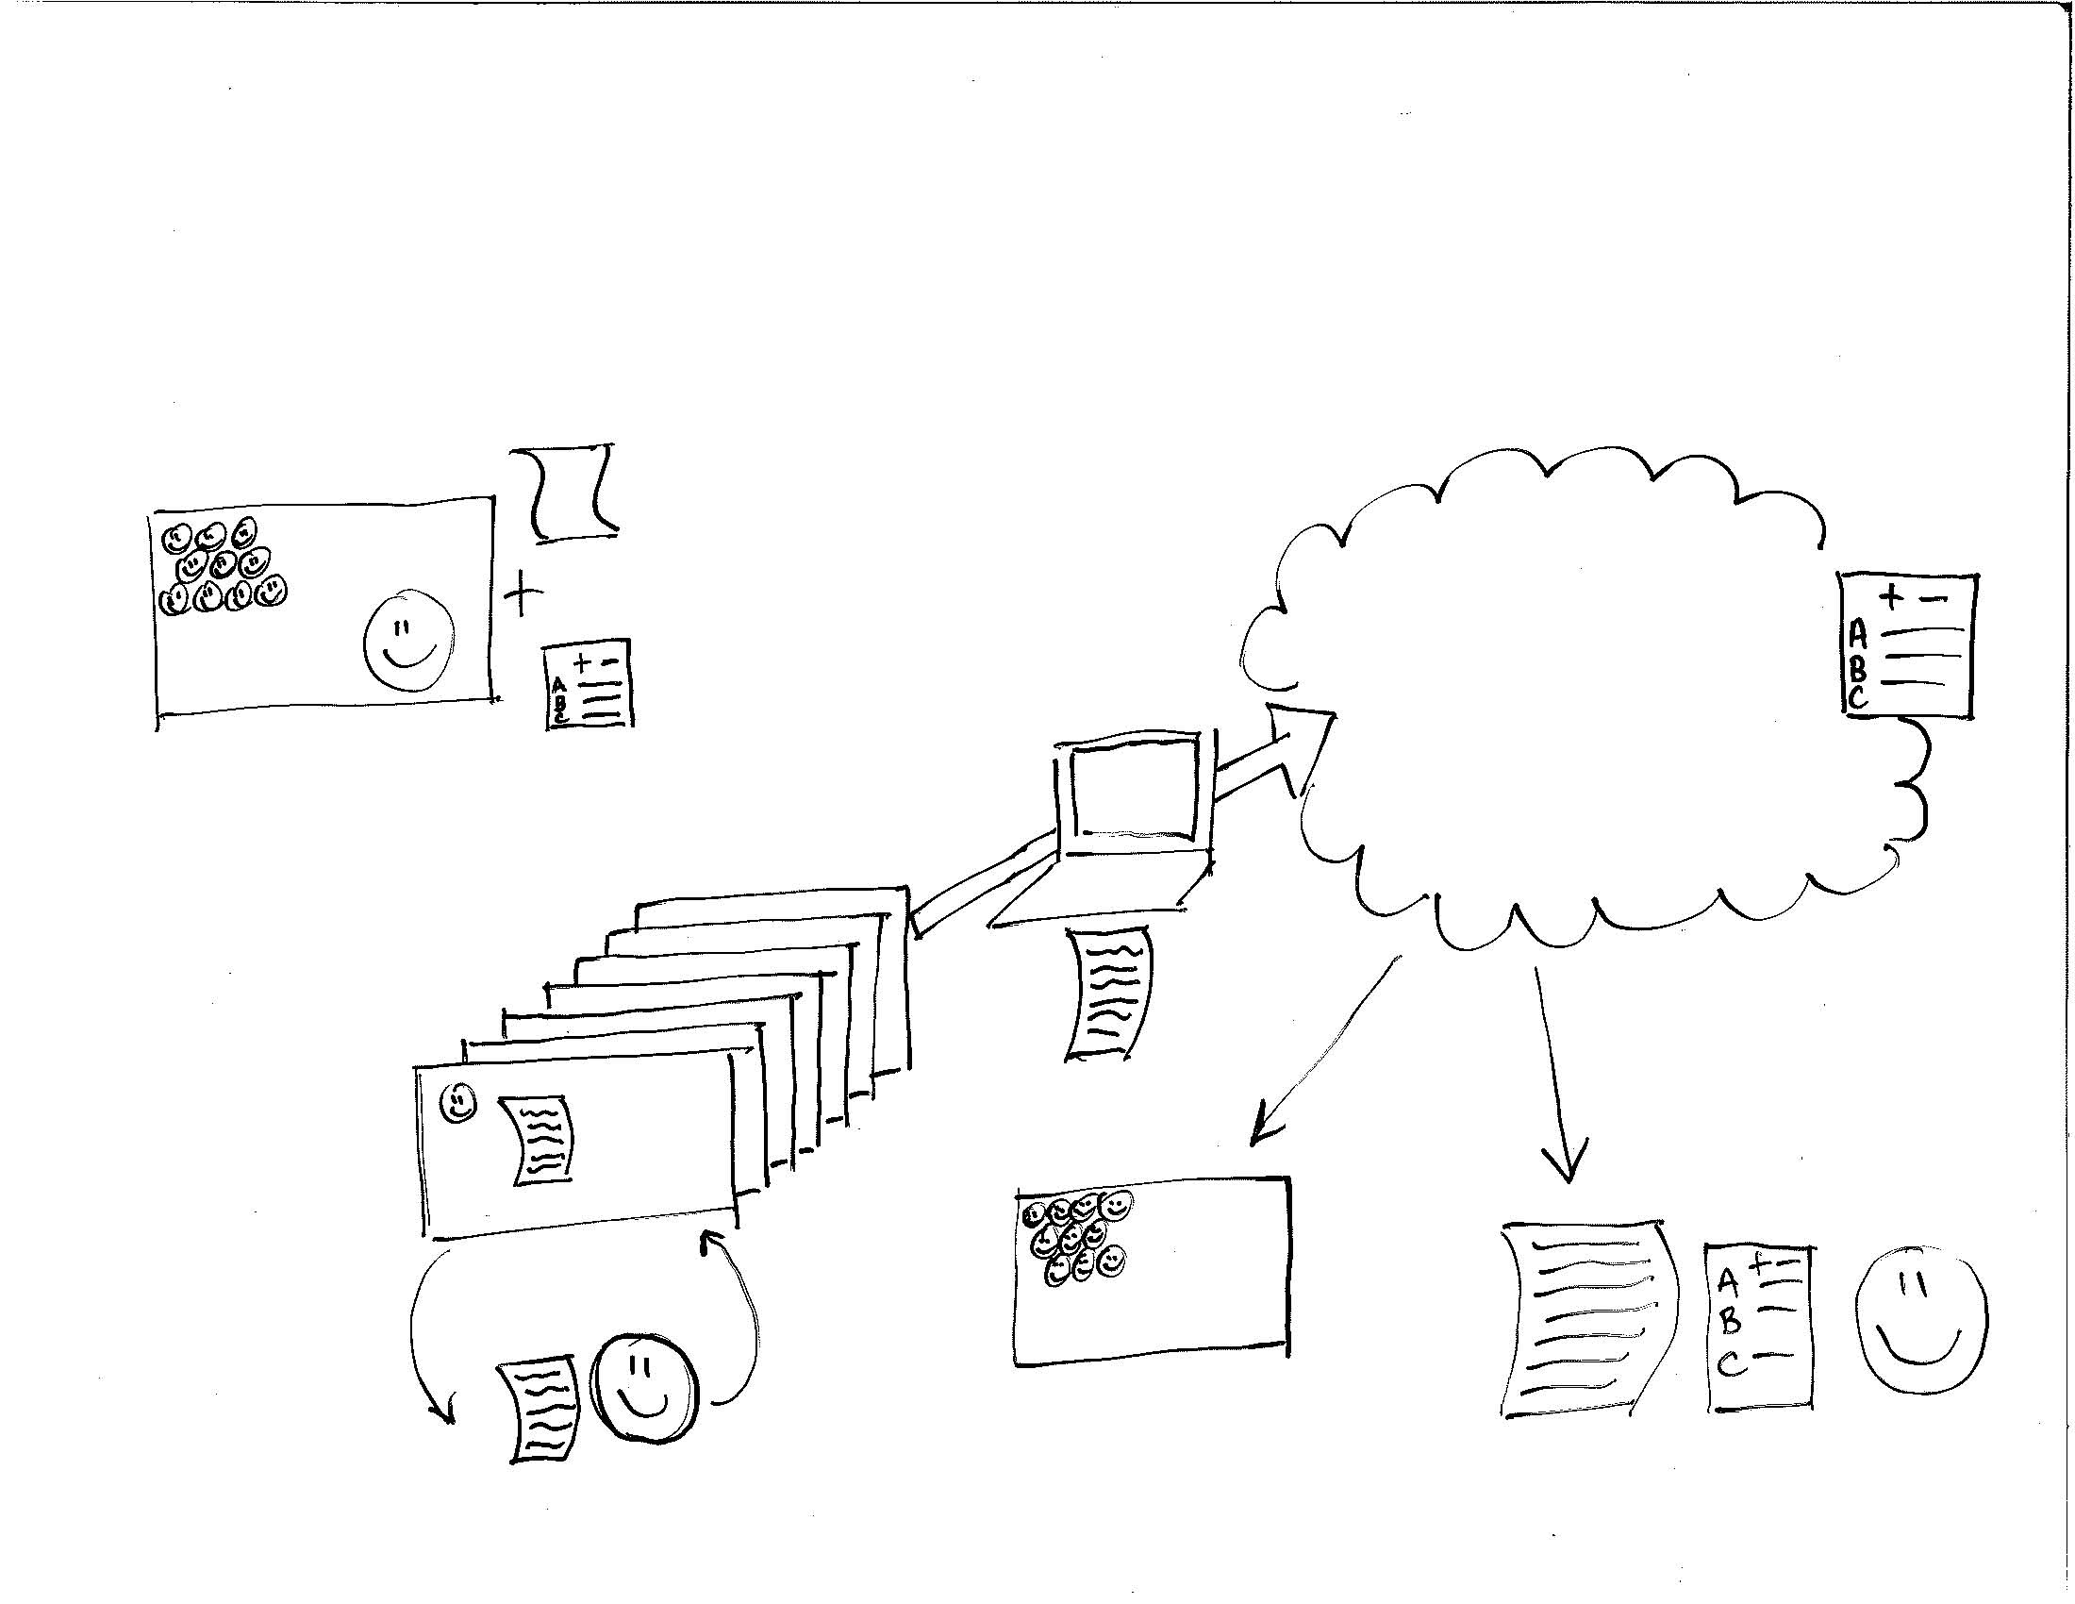
Peer Review Process in SCIE113
Setting up a Framework for Peer Review
Reading
Calibrated
Peer Review
Rubric
Example Essays
Peer & Self Reviews
In-Class Presentation(s)
Intro to Peer Review
Calibrated Peer Review
Anonymous
Online
Writing
Assignments
Three in-class essays
Term project
Essay
Peer Review Debrief
In-class discussion
Submit Revised Essay
Graded by Instructor
Submit to Instructor
Notes:
JOANNE

Slide 10
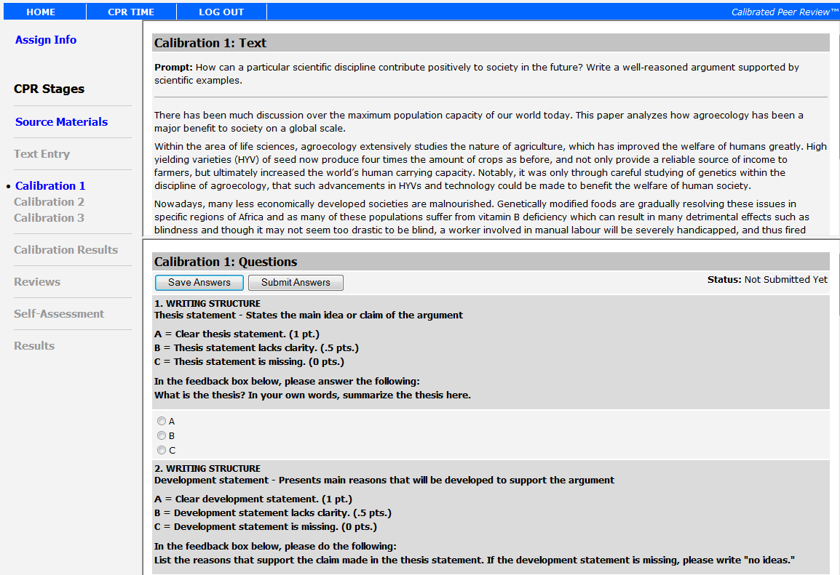
Notes:
Here is an example of the screen displayed during the Calibration stage. The goal of this stage is to help you better understand how to rate the writing of others. In the Calibration stage, you will be asked to read and rate three sample essays. The essays represent poor, moderate and high quality work and will be presented in random order. You will be asked to rate each essay on a number of criteria and assign a final point value to each essay. You will need to click the Submit Answers button to progress to the next calibration essay.
The calibration essays have been reviewed by the SCIE113 course development team, the instructors and some students. Based on the feedback from these reviewers, a correct answer has been selected for each criteria. Your goal is to match the correct answers as closely as possible. By answering a pre-determined number of questions correctly and rating the essay within a set range, you will “master” the essay. You will earn points for each calibration essay you master. Your performance on the Calibration stage will also help determine the weight applied to the ratings you give your peers.
If you do not master the calibration essays, you will be given a second chance earn mastery.
The calibration essays and a PDF version of the rubric are available in the course Connect site. You may want to review these prior to the Calibration stage.
You may also notice each criteria asks you to provide specific feedback. Please disregard these questions in this stage as there is no feedback box available. You will need to provide this feedback during the Peer Review stage.

Slide 11
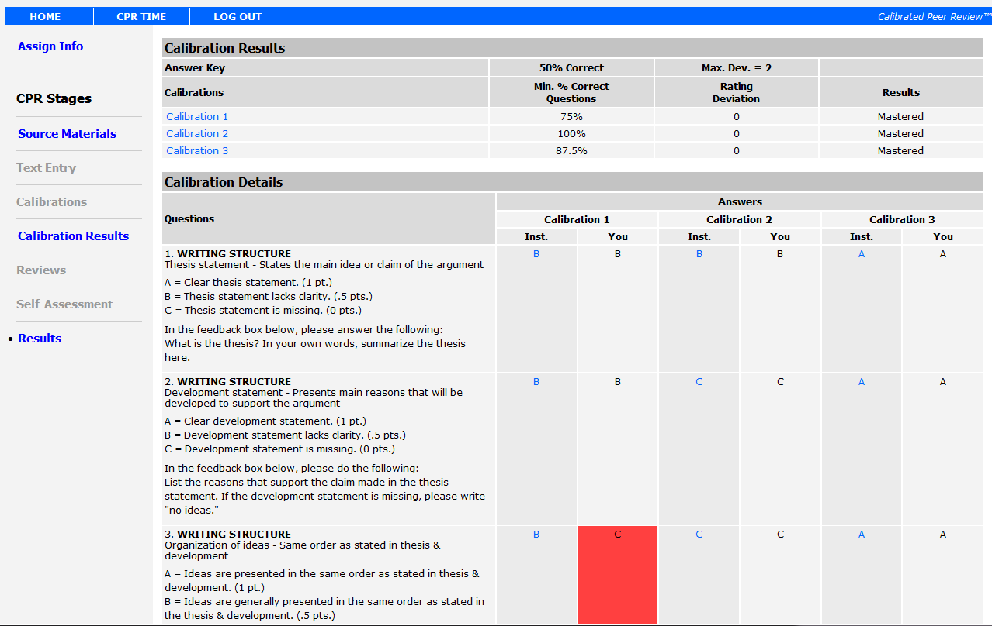
Notes:
Here is an example of what your Calibration Results will look like. At the top of the screen you will see an overview listing what percent of the questions you answered correctly, how much your rating deviated from the correct rating and whether you mastered the calibration. Below that, you will see your answers displayed next to the correct answers for each essay. You can click the blue instructor answer to view an explanation of why that answer was correct.

Slide 12
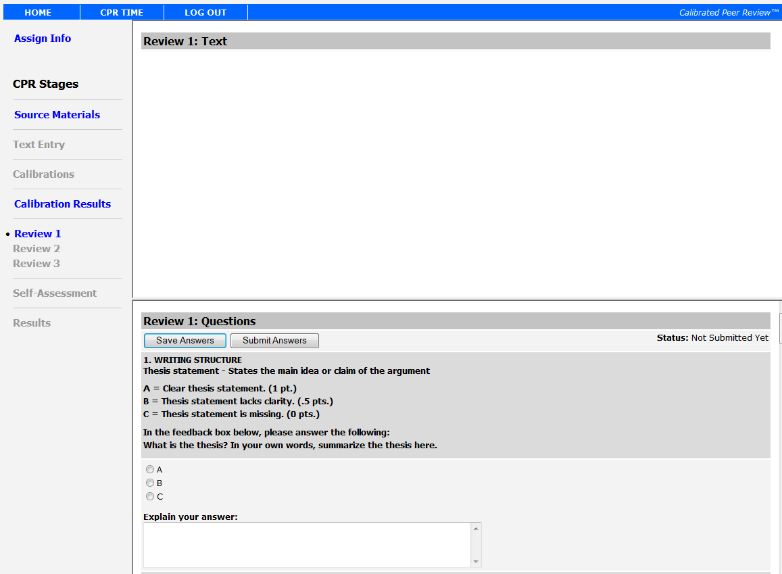
Notes:
In the Review stage, you will be asked to rate and provide feedback for three essays written by your peers. You will use the same rubric as you did for the Calibration stage, but will now be prompted to enter feedback as well. Most students report that the feedback is more helpful than the rating since it provides specific information on how they might improve their work. Please be sure to provide feedback and answer the questions included in the rubric.
When you have completed the first essay, click the Submit Answers button to access the next essay. You will not be able to change your answers, so be sure you are ready to submit before you click the button.
After you review three of your peers’ essays, you will be asked to review your own work (Self-Assessment). You will again use the same rubric, but will not be expected to provide feedback. By the time you reach self-assessment, you will have seen 3 calibration essays and 3 essays from your peers. You should be able to look at your own work critically and start thinking about how you might improve your work.

Slide 13
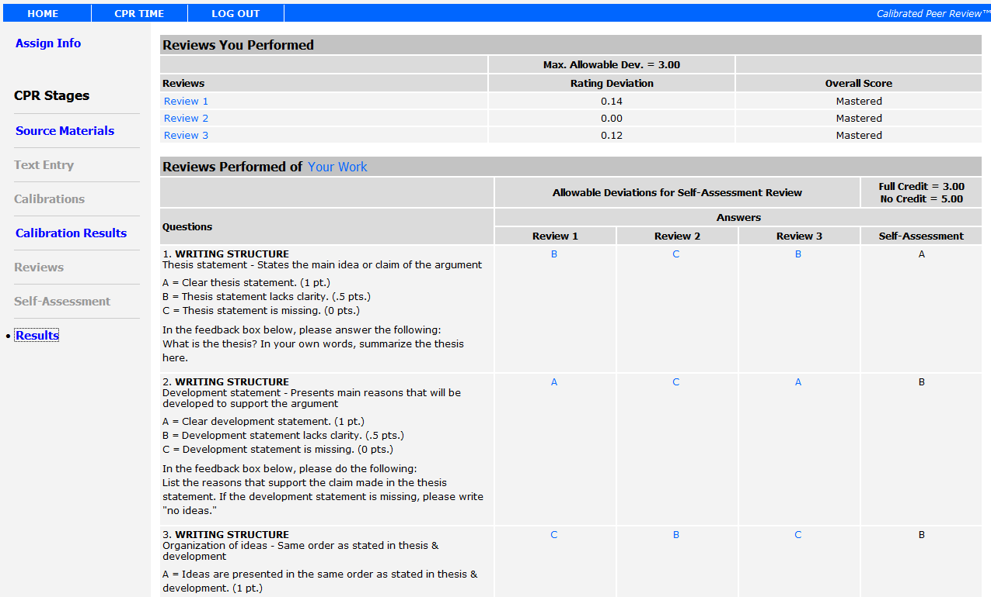
Notes:
Once the Peer Review stage has ended, you will be able to see your Results. Here is an example of the Results screen. At the top of the page, you see the reviews you performed, how much your rating deviated from the rating average and whether you mastered the review. You master the review simply by rating the work within the allowable deviation.
Below that, you see how your peers rated your writing, along with your self assessment. It is normal and expected to see variations in the ratings. This is both because you are still learning to be peer reviewers and because people will disagree. You will likely find it helpful to click the blue rating to see the feedback provided. Pay extra attention to any areas where your self-assessment differs from your peers.

Slide 14
Calibrated Peer Review
Calibration
Essays
x3
RUBRIC
Peer Reviews
X3
Self Assessment
Notes:
JOANNE

Slide 15
Calibrated Peer Review
Calibration
Essays
x3
RUBRIC
Peer Reviews
X3
Self Assessment
Notes:
JOANNE

Slide 16
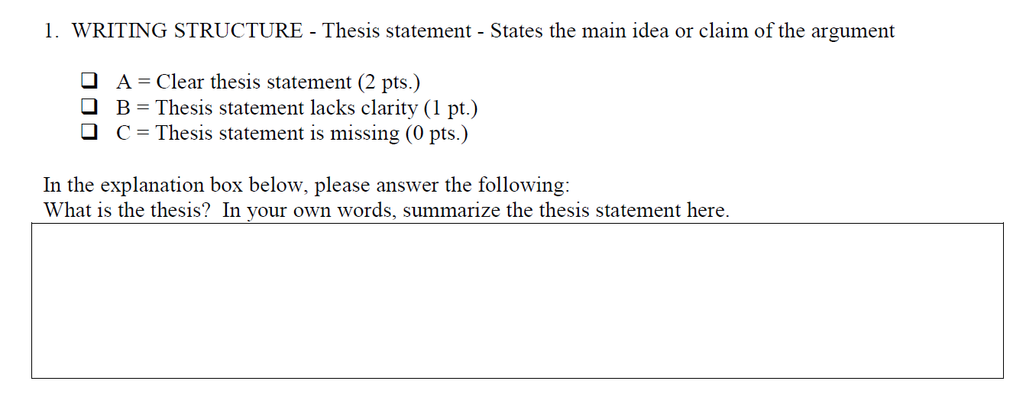
Guiding Student Feedback
Reading and evaluating my peer's papers accurately was difficult, because I was unsure if I was doing it correctly even though I did do my best. I was worried that I would be grading incorrectly.
Student in SCIE113
Notes:
JOANNE
Nelson, L. (2003). Improving student peer feedback. College Teaching. 51 (1). http://cis.apsc.ubc.ca/wiki/images/2/28/Usj.pdf

Slide 17
CPR Results Overview
Writing Assignment #1
Writing Assignment #2
95% completion rate
99% of students reviewed feedback
Average text rating = 68%
Average score = 87%
89% completion rate
97% of students reviewed feedback
Average text rating = 67%
Average score = 80%
Notes:
ANDREA
No improvement from WA1 to WA2 – made more challenging (needed to answer more questions correctly on calibrations, lower value to self review), also developmental nature of writing
Issues – deadlines & reminders

Slide 18
What is the most useful part of the peer review process?
“Reviewing other students' work and observing what they did well, and trying to incorporate that structure into my own work. ie seeing a strong, concise thesis statement and rewriting my own to be stronger and more concise in its own way.”
“Being able to get a good look at three other papers, this gives a better understanding of what level your writing is currently at.”
“The peer feedback allowed myself to see how my audience would interpret my writing.”
“Allows you to get perspective, opens you up to new suggestions or ideas you may not have thought of yourself.”
“Generally it showed me that I still have a lot to learn after 19 years, and peer review actually speeded up the process.”
Students in SCIE113
Notes:
ANDREA

Slide 19
Time spent for each CPR stage
Notes:
ANDREA

Slide 20
How do you prepare students to provide useful feedback?
How can we encourage students to use peer feedback?
Notes:
ANDREA

Slide 21
Did you find the peer feedback useful?
Notes:
JOANNE
Yes – New ideas/perspective, identify weak points and improve writing
No – no feedback, already knew, didn’t understand assignment

Slide 22
How did you incorporate feedback
from your peers in your writing?
Notes:
JOANNE

Slide 23
Student Views of Peer Review
…when feedback differed from person to person (which it did multiple times), it was hard to determine which feedback to take seriously. Nevertheless, the feedback required me to further review my writing.
After my initial anger wore off, I tried to put myself into their shoes to get a better understanding of how I can improve my work…
oftentimes i suspect parts of my essay need to be reviewed and my peer’s feedback just reassures my suspicions.
Calibrated
Peer Review
Example Essays
Peer & Self Reviews
Anonymous
Online
I tried to look at my essay from their point of view. If I felt that they were right, I would rewrite certain parts; if I felt that their comment didn’t offer much insight, I would keep it the way I already had it.
Peer Review Debrief
In-class discussion
Submit Revised Essay
Graded by Instructor
Notes:
JOANNE

Slide 24
Want to know more about CPR or SCIE113?
Let us know!
Joanne Fox Andrea Han
joanne@msl.ubc.ca andrea.han@ubc..ca
Modified from Question by Anas Ramadan, from The Noun Project
Notes:
JOANNE

