Slide 1
Just in Case vs Just in Time Learning Models
Thinking Session
How can the quality of instructional skills development be improved by moving from a "Just in Case" model to a "Just in Time" model?
Carson Au, Learning Technology Specialist, SFU

Slide 2
About Me
Name: Carson Au
Learning Technology Specialist, SFU
IT background, where the main goal was to reduce the number of help calls
New to the Teaching and Learning Center, SFU, where the goal is to engage faculty members
Notes:
Why does this topic interest me?

Slide 3
Some Background
Faculty members are extremely busy
Instructional skills development often is not their top priority
Reason for this topic: I am putting together a case to promote using JIT Learning to improve instructional skills development
Notes:
Why does this topic interest me?

Slide 4
Rules of our Thinking Session
Participate
Have fun!

Slide 5
Game plan
What is Just in Case (JIC) learning?
JIC Examples?
JIC Cons?
What is Just in Time (JIT) learning?
JIT Examples
JIT Pros? (see how I am NOT bias?)
JIT Case Study
Help ETUG University - you be the judge!

Slide 6
Just in Case Model
What is it?
Have you ever asked:
‘Why do I need to know this?’
Then be told:
‘because someday you will need it’?”
Did that motivate you to apply yourself?

Slide 7
Just in Case Model
Each table, come up with:
3 Examples of JIC
3 Cons of JIC
You have 3 Minutes!
GO!

Slide 8
Just in Case Examples
This Presentation?
Notes:
Examples of Just in Time training:
- School
- Seminars
- Etug?

Slide 9
Why not Just in Case?
Notes:
Users forget “how” when they actually need it.

Slide 10
Just in Time Model
What is it?
Learner Centric
Provides when needed
Customized content
Can be web based
Can have coaches on stand-by

Slide 11
Just in Time Model
Each table, come up with:
3 examples of JIT
3 Pros of JIT
You have 3 Minutes!
GO!
Notes:
Examples of Just in Time training:
- Tech Support, screencast videos
- Youtube (or what old timers call on demand instructional videos)
- Project groups

Slide 12
Just in Time Examples
Notes:
Examples of Just in Time training:
- Tech Support, screencast videos
- Youtube (or what old timers call on demand instructional videos)
- Project groups

Slide 13
Just in Time Examples
Notes:
Examples of Just in Time training:
- Tech Support, screencast videos
- Youtube (or what old timers call on demand instructional videos)
- Project groups

Slide 14
Why Just in Time?

Slide 15
Case Study - the Apple Store

Slide 16
Case Study - the Apple Store

Slide 17
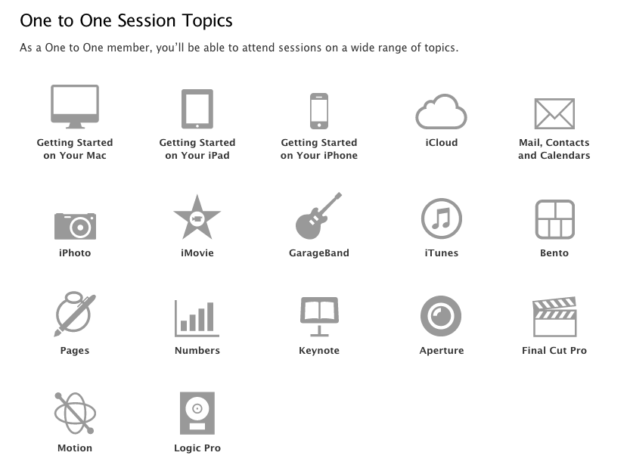
Case Study - the Apple Store

Slide 18
Game - Help a professor
Three Team leaders
Assemble a small team, ideally with people from different institution
Spend 7 mins to design a plan to help the chosen instructor with JIC/JIT solutions
You will have 3 mins to present your plan to your professor
There are no wrong answers

Slide 19
Game - Help a professor
The rest of you can hop around different teams to participate
Audience will be the judge
Ready to meet the Faculty Members?

Slide 20
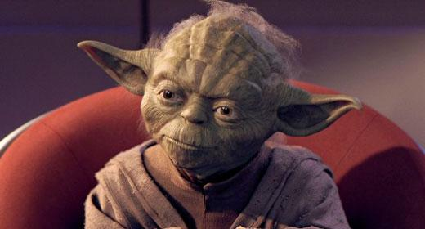
1) Professor Yoda - Faculty of the Force
Legendary wisdom, mastery of the Force
Considering new pedagogical models for his Jedi Development Program

Slide 21
2) Professor Leia - Political Science
Loves engaging students
Has no time to learn new technology
Was convinced by her students to try out new LMS

Slide 22
3) Professor Vader - Faculty of the Dark Side
Limited people skills
Interested in working on his Voice and Presentation Skills

Slide 23
Thank you
Carson Au - cau@sfu.ca

