Slide 1
The Envelope Please……
Lessons from Okanagan College’s first Online Learning Quality Awards

Slide 2
Why?
To aid in the implementation of quality culture as it pertains to online courses.
To engage faculty.
To highlight and reward faculty that are using the LMS well.

Slide 3
How?
Clear quality standards and ensure the standards are easy to access and easy to follow.
Seek 3 peer reviewers and make it easy for them to review. Give them adequate time.
Brand the quality awards and promote internally.
Present to faculty and include the winner in the presentation.
Reward the winner with a decent prize.

Slide 4
So What?
Lesson: In your first year don't worry about the number of entries; just get it going.
Impact: at faculty presentation I had 5 times more attendees than a typical workshop. They all learned about what makes a good quality course.
Impact: Winner is regarded as a peer expert in the LMS.
Impact: engagement happens - faculty talk about "next year's awards“.
Notes:
We had 5 entries, 3 from the same department

Slide 5
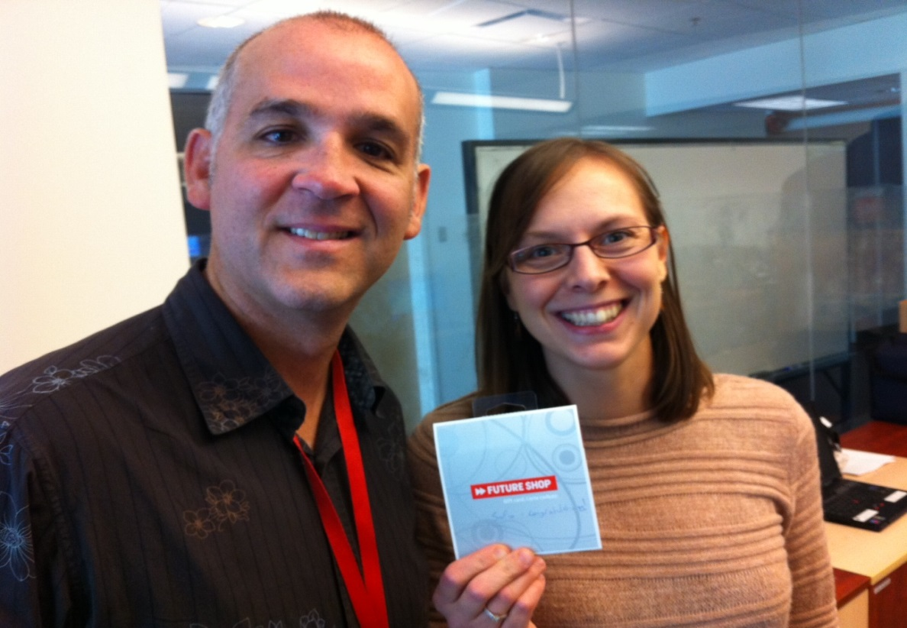
Links
Winning Course
Quality Tool

Slide 6
Questions?

