Slide 1
Notes:
Speaking notes:
Title and topic introduction
Who we are….
Eva: Assistant Professor in Conflict Analysis and Management Program in the School for Humanitarian Studies at RRU
Amanda: Instructional Designer in CTET at RRU

Slide 2
Notes:
Speaking notes:
5 minutes
Eva: Concept and overview (Context)
1st assignment for 1st course of program
Online and pre-residency, students have never met before
Sense of group, individuals, familiarity with reading and materials
Amanda: Technology and Goal
Find a different format for a community building activity. Tired of the discussion forum format and there was a need for more technology and innovation from the program 5 year review.
Been in a workshop and introduced to Popcorn Maker and suggested it to Eva.

Slide 3
Notes:
Speaking notes:
5 minutes
See handout
Eva – do a brief overview of the assignment- what was the intended outcome?

Slide 4
Notes:
Speaking notes:
15 minutes.
Christine, Nick, Maggie
Amanda introduce the student videos with instructions to the audience:
Watch each clip
Using the assessment criteria sheet take notes as you watch each video, respond to some of the questions on the sheet.
Grade the videos in how they each meet the assignment description and the matrix on the document

Slide 5
Notes:
Speaking notes:
What did you think?
Audience reaction?
1st, 2nd, 3rd?
Eva to lead..
Academic rigor- how best set up the assignment, how to gauge academic assignment?

Slide 6
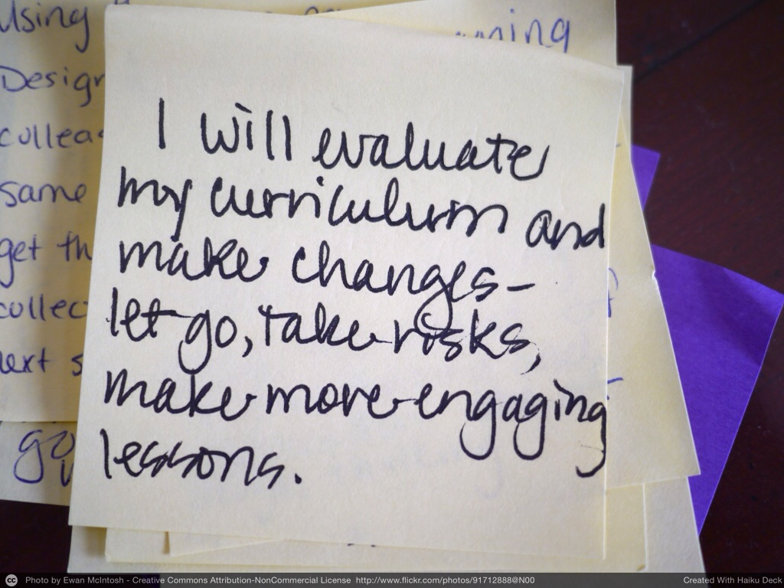
Notes:
Speaking notes:
Feedback from students,
Challenges and lessons learning:
AC: Feedback based on online discussions and in class debrief- community – AC check emails
Eva: Instructor Observations

Slide 7
Notes:
Lessons learned:
Eva:
Vagueness helps creativity
Creativity helps challenge
Challenge helps community
Community helps learning

Slide 8
